Slide 1
Formative assessment in Science and Maths Education
Refer to module 1 and 2 materials

Slide 2
FP7 research project
To research the use of technology in formative assessment classroom practices in ways that allow teachers to respond to the emerging needs of learners in mathematics and science so that they are better motivated in their learning of these important subjects.

Slide 3
Objectives:
To adapt and develop existing research-informed pedagogical interventions (developed by the partners), for working with learners and transforming teaching through:
fostering high quality interactions;
expanding our knowledge of technologically enhanced teaching and assessment methods in mathematics and science.

Slide 4
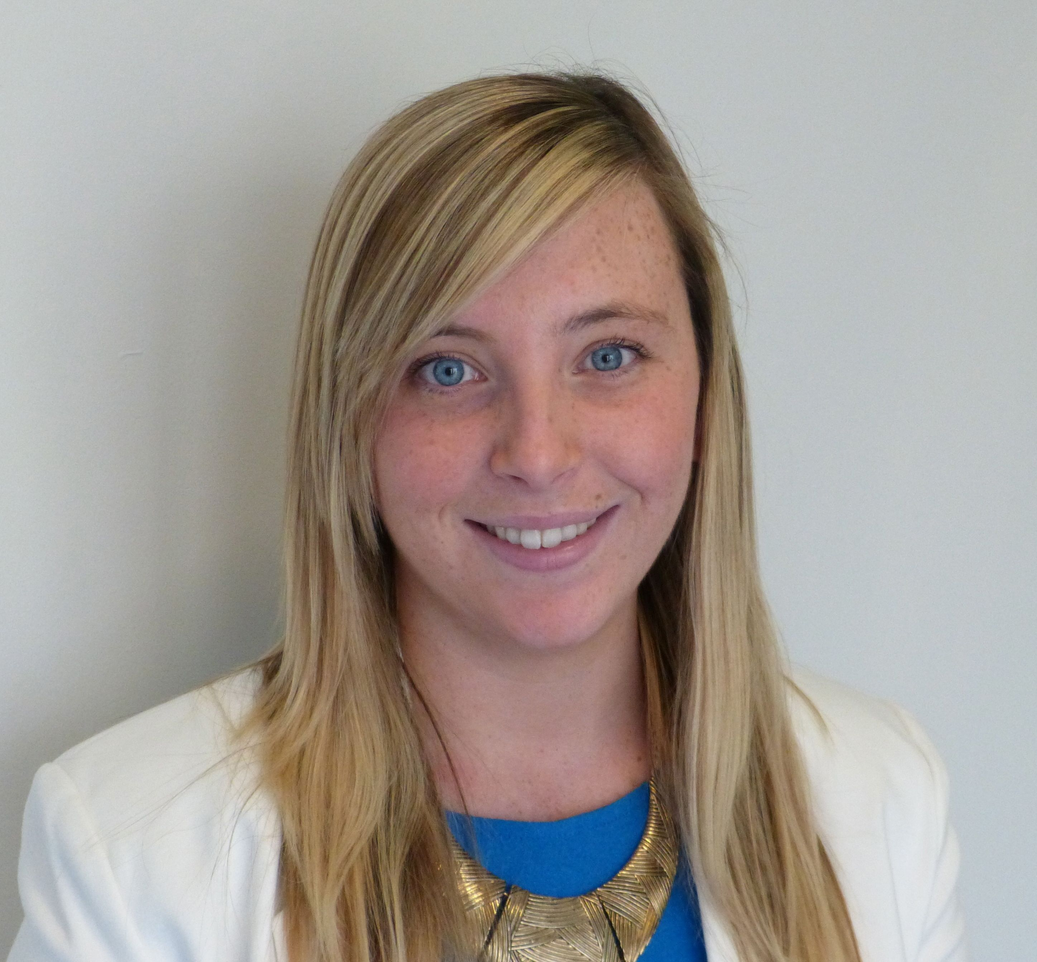
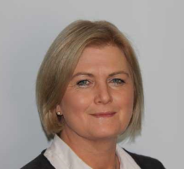
Our Team
Niamh Burke
Project Administrator
Majella Dempsey
Project Leader
Ann O’Shea
Maths Expert

Slide 5
Building on Prior Knowledge
Session 1

Slide 6
Introduction
Research shows that teaching is more effective when it assesses and uses prior learning so that the teaching may be adapted to the needs of students (Black & Wiliam, 1998).
Prior learning may be uncovered through any activity that offers students opportunities to express their understanding and reasoning. It does not require more testing.
For example, it can take the form of a single written question given at the beginning of a session to elicit a range of explanations that may then be discussed.

Slide 7
Introduction
This process, often referred to as formative assessment, may be defined as:
"... all those activities undertaken by teachers, and by their students in assessing themselves, which provide information to be used as feedback to modify the teaching and learning activities in which they are engaged. Such assessment becomes ‘formative assessment’ when the evidence is actually used to adapt the teaching work to meet the needs." (Black & Wiliam, 1998 para, 91)

Slide 8
Introducing Formative Assessment
Why do you assess students?
What different purposes do your assessments serve? Make a list.
Notes:
Activity A
10 minutes

Slide 9
Introducing Formative Assessment
Two main purposes of assessment:
Summative assessment - to summarise and record overall achievement at the end of a course, for promotion and certification. Most ‘high stakes’ tests and external examinations are designed for this purpose. Summative assessment is also used to evaluate the relative effectiveness of a particular course, teaching method, or even an institution.
Formative assessment – to recognise achievements and difficulties at the beginning or during a course, so that teachers and students can take appropriate action. This type of assessment forms an integral part of all learning.

Slide 10
Your Experiences of Formative Assessment
Working in pairs consider the following questions:
Think of two students in your class, one who is particularly strong and one who is finding the work very difficult. Take it in turns to describe the students' strengths and difficulties to your partner, in as much detail as possible.
How did you become aware of these strengths and difficulties? On what evidence do you base your judgments? Test results? Memories of oral responses during lessons? Observations of the student working? Written work?
In what ways do your assessments of these students affect your lesson planning? Give examples.
Notes:
Activity B
10 minutes

Slide 11
Difficulties with Formative Assessment
Read through Handout 1 and consider the following questions:
How far are the criticisms on the handout valid in your context?
If any are, then what may be done about them?

Slide 12
Principles for Formative Assessment
Bearing in mind the difficulties discussed previously, how would you suggest that your formative assessment practices be improved?
Discuss the principles outlined on Handout 2.
Which of these do you currently use in your own teaching?
Which do you find most difficult? Why?
What other principles do you think are important?
Notes:
Activity C
20 minutes

Slide 13
Principles for Formative Assessment
“It's all very well telling us to assess our students, but how can a busy teacher know what is going on inside 30 individual heads?"
How would you answer this teacher?
What strategies do you have for finding out what students are thinking in your lessons?
Discuss the suggestions shown on Handout 3.
Suggest some further strategies for making reasoning more evident.
Notes:
Mini-whiteboards are an indispensable resource for the following reasons:
When students hold their ideas up to the teacher, it is possible to see at a glance what every
student thinks. During whole class discussions, they allow the teacher to ask new kinds of question (typically
beginning: ‘Show me an example of....’). They allow students to, simultaneously, present a range of written and/or drawn responses
to the teacher and to each other.
Posters are also a powerful way of helping students to externalise their thinking. This use does not require 'polished', 'complete', 'attractive' products but rather they should be seen as working documents. Perhaps the simplest way of using a poster is for students to solve a problem collaboratively, explaining the thought processes involved at every step. A second use of posters is to find out what they already know about a given topic. In the diagram shown on Handout 2, the teacher asked students to write down all they knew about y=2x-6. As a class, the diagram was developed on the whiteboard. Students were then given a variety of equations (the level of challenge was varied appropriately) and were asked to produce their own poster. The discussion enabled the teacher to assess how much learners knew about equations and how well they were able to link the ideas together.

Slide 14
Analyse Student Responses to Problem Solving Tasks
Handout 4 presents three problems together with four student responses on each. The tasks are: Counting Trees, Cats and Kittens, Security Cameras.
Read through all three tasks then choose one task that will be most suitable for a class you will soon teach. If you are working on this module in a group, it will be helpful if each participant chooses the same problem, as this will facilitate the follow-up discussion.
Consider the four student responses. What does each student’s response tell you about his or her capacity to use each of the processes: represent, analyse, interpret and evaluate, communicate and reflect?
Notes:
Activity D
20 Minutes

Slide 15
Analyse Student Responses to Problem Solving Tasks
Handout 5 offers some comments on students’ responses to each of the tasks.
If you were the teacher of these students, what feedback would you give them, to help them improve their responses?
Try to frame this help in the form of oral questions you could ask in the classroom. You may find it helpful to refer to the generic questions given on Handout 6.
Notes:
Get Video Links!

Slide 16
Consider the Effects of Feedback on Student Learning
Watch the video of Andrew's students as they discuss the impact of assessment feedback on their learning.
Which of their comments strike you as particularly perceptive and important?
What are the implications of their comments?
http://www.map.mathshell.org/static/draft/pd/modules/1_Formative_Assessment/html/videos_g1.htm
Notes:
Activity H
20 minutes

Slide 17
Analyse Student Responses to Concept Focused Tasks
On Handout 7, we present four mathematical topics and some sample student work on each one.
Assess each response and try to identify the reasoning that lies behind each one.
Notes:
Activity E
20 Minutes

Slide 18
Analyse Student Responses to Concept Focused Tasks
Some questions that might help:
What does the student appear to understand? Where is your evidence?
List the errors and difficulties that are revealed by each response.
Try to identify the thinking that lies behind each error.
What feedback would you give to each student?

Slide 19
Identifying Misconceptions
There are two common ways of reacting to pupils' errors and misconceptions:
Avoid them whenever possible: "If I warn pupils about the misconceptions as I teach, they are less likely to happen. Prevention is better than cure."
Use them as learning opportunities: "I actively encourage pupils to make mistakes and learn from them.
What is your view?

Slide 20
Identifying Misconceptions
Handout 8 is a one page research review by Askew and Wiliam. This describes some research that was conducted in Britain over the past 30 years on dealing with student errors and difficulties.
How do you feel about the dilemmas presented in this paper? - is it possible to present examples where rules do not work? - do you share the view that it is counter-productive to teach simpler examples before more complex examples?

Slide 21
Plan and Report Back on an Assessment Lesson
What we want you to do over the following week:
Plan your own lesson using one of the problems.
Plan a time for students to tackle the problem on their own without help.
Plan how you will assess this work, give feedback and conduct a follow up lesson.
Collect samples of students' work to show how their thinking has changed. These will be discussed at the follow- up session.
Notes:
To help your planning, you may now like to watch one of the three 10-minute videos that show Andrew, Dominic and Amy teaching the three problems from Activity D. They are each following the lesson plan on Handout 9.

Slide 22
Plan and Report Back on an Assessment Lesson
Video: teachers teaching their formative assessment lessons
http://www.map.mathshell.org/static/draft/pd/modules/1_Formative_Assessment/html/videos_f1.htm
Handout 9 provides you will a formative assessment lesson plan that will help you in your planning.

Slide 23
Plan and Report Back on an Assessment Lesson
After you have taught the lesson, reflect on what happened with a group of colleagues. Take it in turns to share stories of the assessment strategies you used.
How did you collect and assess evidence of your students' work?
What did you learn from this evidence?
What did students learn from the follow-up lesson?
What are the implications for you mathematics teaching more generally?

Slide 24
Conclusion
Discuss some ways of applying what you have learned in this professional development module to the other mathematics or science lessons that you teach.
How could you involve pupils in improving your assessment practices?

Slide 25
Our Deliverables:
Offer approaches for the use of new technologies to support the formative assessment of lower achieving students.
Develop sustainable teaching practices that improve attainment in Mathematics and Science for the targeted students.
Produce a toolkit for teachers to support the development of practice and a professional development resource to support it.
Disseminate the outcomes.

Slide 26
Re-Engaging Learners.
Inside mathematics, Re-engaging learners

Slide 27
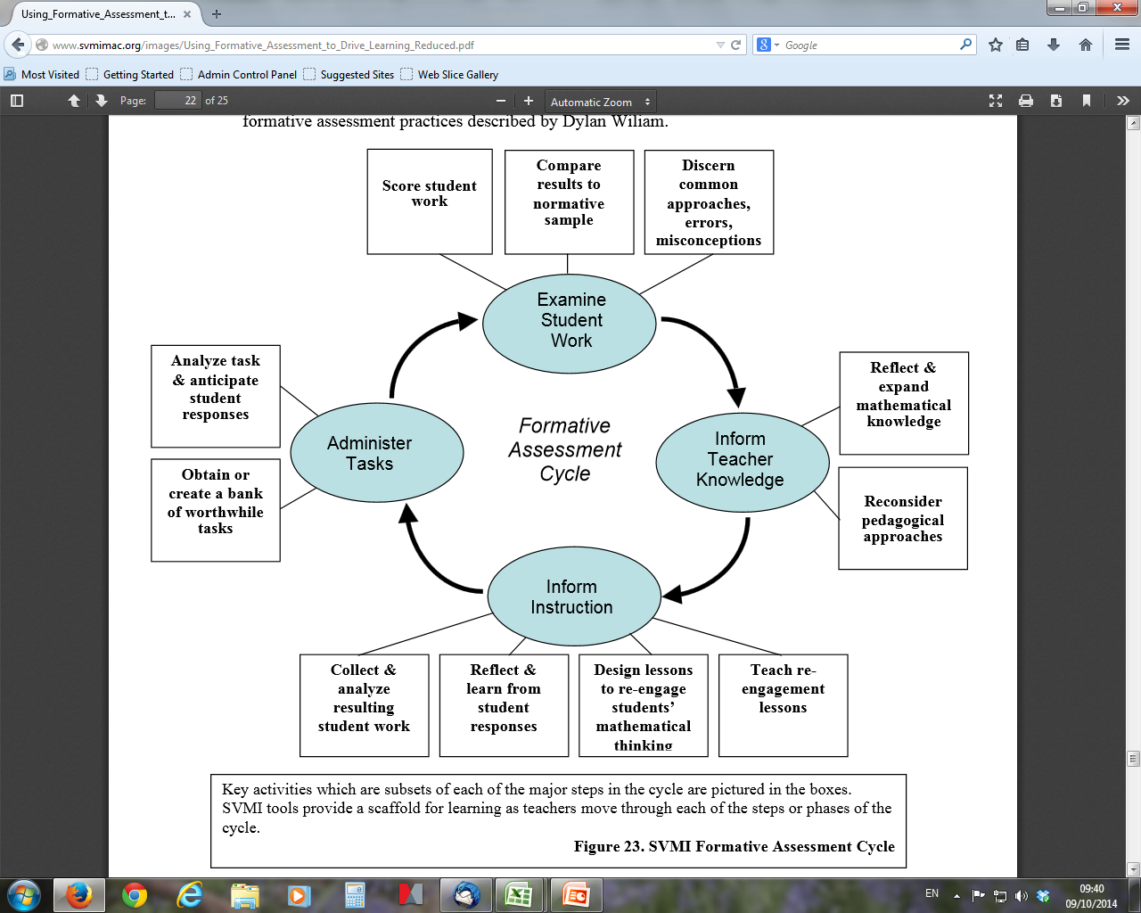

Slide 28
Using the toolkit
Plan an activity
Do the activity
Review the activity

Slide 29
Timeline
Toolkit 1 : November
Toolkit 2: December/January
Toolkit 3 and 4: January/February
Toolkit 5: March
Toolkit 6: April
Finish by end of May 2015
Evaluation of the teaching and learning materials
Dissemination
Stakeholder meetings in 2015 and 2016

Slide 30
http://research.ncl.ac.uk/fasmed/

