Slide 1
INTRODUCING
FORMATIVE ASSESSMENT
FaSMEd PROFESSIONAL DEVELOPMENT MODULE

Slide 2
Activity A: What is formative assessment?
Discuss the following questions and think about a few specific examples:
Why do you assess students?
What different purposes do your assessments serve? Make a list.
Handout 1: The importance of formative assessment discusses the potential of formative assessment to improve learning

Slide 3
Activity B: Teachers’ own experiences (1)
What strategies do you use to find out what your students know and understand?
Think of two students in your class, one who is particularly strong and one who is finding the work very difficult. Describe the students' strengths and difficulties to your partner.
How did you become aware of these strengths and difficulties? On what evidence do you base your judgments?
In what ways do your assessments of these students affect your lesson planning?
Give examples.

Slide 4
Activity B: Teachers’ own experiences (2)
Handout 2: Difficulties with formative assessment summarises research findings related to the challenges associated with formative assessment.
How far are the difficulties on the handout valid in your context?
If any are, then what may be done about them?
How would you answer a teacher who asks the following? What approaches would you suggest that they use?
“I know it makes sense to assess students as we go along,
but how can I, in the midst of a lesson,
know what each of my 30 students is thinking?”

Slide 5
Activity C: Principles and strategies for FA (1)
Handout 3: Principles and strategies for formative assessment is based on research into formative assessment.
Bearing in mind the difficulties discussed in Activity B, how would you suggest that your formative assessment practices be improved?
Discuss the principles and strategies outlined on Handout 3.
    Which of these do you currently use in your own teaching?
    Which do you find most difficult? Why?
What other principles or strategies do you think are important?

Slide 6
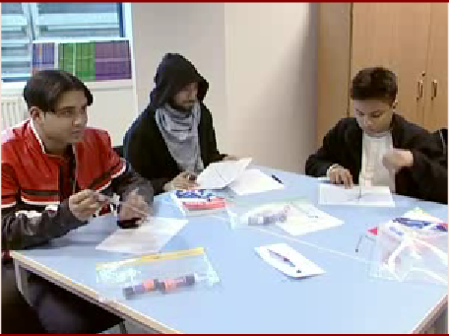
Activity C: Principles and strategies for FA (2)
How does the teacher use formative assessment?

Slide 7
Activity D: Analysing students’ responses (1)
Handout 4: Problem-solving in the classroom (brief discussion about problem-solving and a summary of what is in Handouts 5, 6 and 7);
Handout 5: Counting trees;
Handout 6: Cats and kittens;
Handout 7: Suggestions for questions (a list of generic questions related to the four processes involved in problem-solving above).

Slide 8
Activity D: Analysing students’ responses (2)
Consider the four student responses in Handouts 5 and 6:
What does each student’s response tell you?
What questions you could use to help these students move on?
  (Refer to the generic questions in Handout 7)

Slide 9

Activity E: Observing formative assessment (1)
To what extent do the teachers’ comments resonate with your experience? (answer on Handout 8)

Slide 10

Activity E: Observing formative assessment (2)
What different kinds of assessment can you see?
What is the purpose of each kind of assessment?
What do both the teachers and students learn?
(answer on Handout 8)

Slide 11
Activity E: Observing formative assessment (3)
Five key strategies:
Clarifying/ understanding/ sharing learning intentions and criteria for success;
Engineering effective classroom discussions and other learning tasks that elicit evidence of student understanding;
Providing feedback that moves learners forward;
Activating students as instructional resources for one another;
Activating students as owners of their own learning.

Slide 12

Activity F: The effects of feedback (1)
Which of their comments strike you as particularly important?
What are the implications of their comments?
(answer on Handout 9)

Slide 13
Activity F: The effects of feedback (2)
Handout 9: The effects of feedback on students’ learning.
The dangers of giving marks, levels, rewards and rankings
  What are the implications of this for your practice?
What would happen if you stopped giving marks or level on pupils’ work?
Why are so many teachers resistant to making this change?
The advantages of giving clear, specific, content-focused feedback
What are the implications of this for your practice?
Does this kind of feedback necessarily take much longer to give?

Slide 14
Activity F: The effects of feedback (3)
Handout 10: A formative assessment lesson plan.
Plan a problem-solving lesson (Counting trees, Cats and kittens or something else)
Use the handout as guidance
But make the lesson your own!
Teach the lesson between now and next time
Be ready to report back

Slide 15
Activity G: Exchanging experiences
Handout 11: Exchanging experiences
What worked well and less well in terms of formative assessment?
What did you learn about the students’ understanding from the initial activity?
How did the students respond to your feedback?
What worked well and less well in terms of problem solving?
What are the implications of this lesson for your future teaching?

