Slide 1

Identifying and responding to conceptual difficulties

Slide 2
Assessing students’ responses to diagnostic questions
What do we mean by diagnostic questions?
Let’s look at some genuine student work on handout 1
Work in pairs and write a few lines on:
The nature of the errors that have been made
The thinking that may have led to these errors
Fill in answers onto handout

Slide 3
Possible errors
Plotting points and reading scales
Interpreting points
Interpreting lines
Interpreting global shape of graph
Interpreting intervals
Interpreting gradients

Slide 4
Principles to discuss
How do we normally react to students errors and misconceptions?
Handout 2 describes the advice given in research.
How do you feel about this advice?

Slide 5
Looking at classroom activities

Slide 6
Activity 1: Insulation
Materials required:
Video Clips: Bluetooth Device: http://vnr.st/v190
USB Device: http://vnr.st/v19
Each student will need two copies of the pre-assessment task and access to their individual ‘schoology’ account.
Each group will need a temperature probe, kettle, water, two plastic containers with lids, thick wad of kitchen paper and elastic band
Each group will need access to a laptop or iPad for the logger lite software.

Slide 7
Activity 1: Insulation
Lesson Outline:
Pre-assessment task
Assessing student responses
Technology introduction
Insulation activity
Analysing and interpreting the data
Improving solutions to pre-assessment task

Slide 8
Procedure:
Boil the kettle. and pierce a small hole in the lid of each container.
Wrap a thick wad of kitchen paper around one of the cans.
Place exactly 100 cm3 of the boiled water into each of the cans.
Place the lids on the cans.
Place a temperature sensor through the hole in each lid so it reaches the hot water.
Start collecting temperature data.
Collect data for 10 minutes.
Stop and autoscale the graph.
Repeat the procedure twice more for validity.

Slide 9

Questions arising from the activity

Slide 10
Analysing the data
Students should now have a graph with all of their experiment results on the logger lite programme. Encourage students to analyse and interpret this data.
Students will then upload their graphs to the class ‘schoology’ page.
This activity may take time as students may find it difficult to upload the graphs. You should practice this yourself before coming into class so that you are familiar with the process.

Slide 11
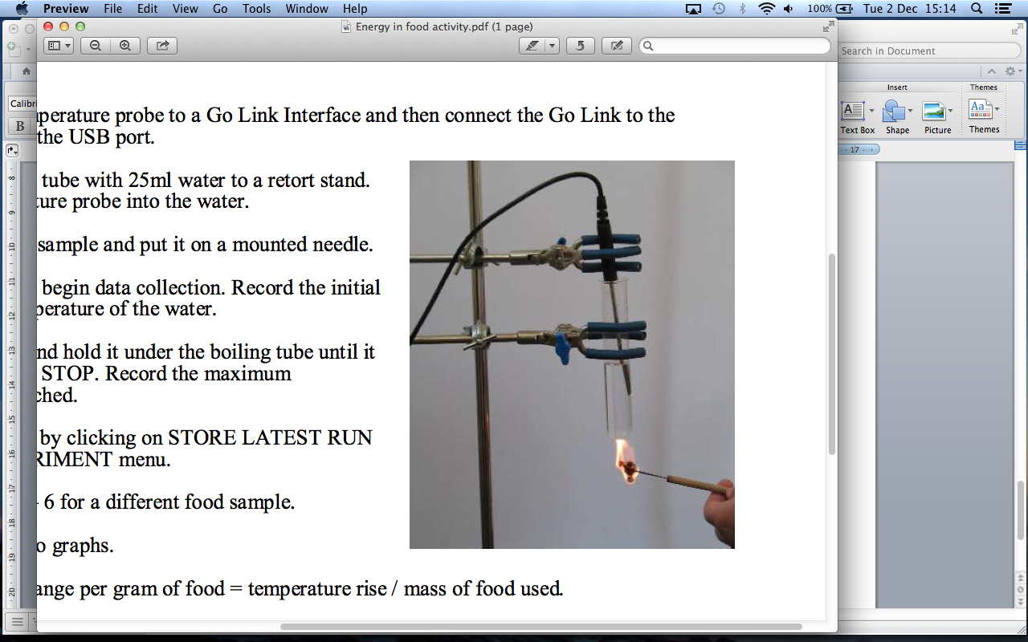
Activity 2: Energy in Food
Work through activity 2 with a colleague and write your notes onto handout 3.

Slide 12
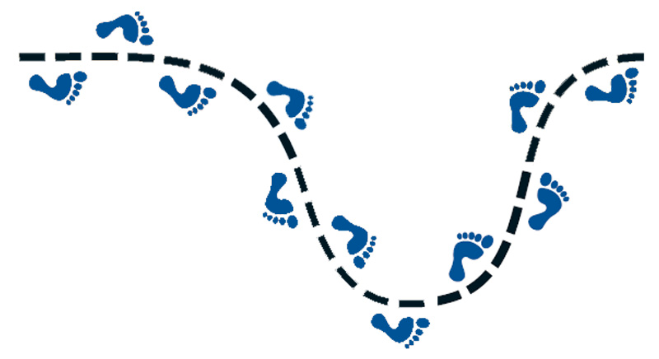
Next Steps…

Slide 13
Other Important Information:
Coding student data and making it anonymous.
Teacher reflection sheets.
Participation certificates
Your questions…

