Slide 1

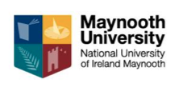
Improving Questioning and Increasing Student Collaboration
Refer to Module 3 and 4 materials

Slide 2
FaSMEd Timeline
December 2014: Activity 1
Building on Prior Knowledge and Feedback
February 2015: Activity 2
Identifying and Responding to Conceptual Difficulties
March 2015: Activity 3 and 4
Improving Questioning and Increasing Student Collaboration
April/May 2015: Activity 5 and 6
Students as Assessors and Planning Lessons with Formative Assessment

Slide 3
Improving Learning through Questioning
Activity 3

Slide 4
Improving Learning through Questioning
This unit is designed to help you make effective use of questioning by considering the type of questions you may ask students, particularly those that will help develop their thinking and reasoning rather than their recollection of knowledge.

Slide 5
Reflecting on the questions we ask:
Looking at Exemplars K and M, take some time to think about the questions that these teachers are asking.
What different types of questions are there?
What different functions do these questions serve?
Which types of questions do you use most frequently?
You can record your responses on Handout 1

Slide 6
We may ask questions for the following reasons:
to interest, engage and challenge;
to assess prior knowledge and understanding;
to stimulate recall, in order to create new understanding and meaning;
to focus thinking on the most important concepts and issues;
to help students extend their thinking from the factual to the analytical;
to promote reasoning, problem solving, evaluation and the formation of hypotheses;
to promote students’ thinking about the way they have learned;
to help students to see connections.

Slide 7
Reflecting on the questions we ask:
Think about the type of questions you use in the classroom and critically consider the impact on student learning:
What common mistakes do you make when asking questions?
What are the unintended effects of each of these mistakes?

Slide 8
Common mistakes teachers make when questioning:
Asking too many trivial or irrelevant questions.
Asking a question and answering it yourself.
Simplifying the question when students don’t immediately respond.
Asking questions of only the most able or likeable students.
Asking several questions at once.
Asking only closed questions that allow one right/wrong possible answer.
Asking ‘guess what is in my head’ questions, where you know the answer you want to hear and you ignore or reject answers that are different.
Judging every student response with ‘well done’, ‘nearly there’ or ‘not quite’. ‘Well done’ can discourage alternative ideas being offered.
Not giving students time to think or discuss before responding.
Ignoring incorrect answers and moving on.

Slide 9
Wait Time
In a study by Rowe (1974) on ‘wait time’, it was found that teachers were waiting less than one second before intervening if no correct answer was given.
This short period of time did not allow students to analyse the question properly and come up with a sufficient answer.
Increasing student wait time leads to the following:
Students’ answers are longer.
Responses are more confident.
Failure to respond decreases.
Students challenge other answers.
Alternative explanations are offered

Slide 10
What type of questions develop thinking and reasoning?
Some questions can be more effective in developing student thinking and reasoning than others.
By considering some of our examples what conclusions can you reach? Consider:
The types of questions that promote thinking and reasoning
The examples that you have recently used that stimulated students’ thinking
The implications of these ideas for your own practice.
You can record your responses on Handout 2.

Slide 11
What type of questions develop thinking and reasoning?
Handout 3 contains a summary of some research findings into the use of questioning.
Consider these research findings and the implications for your own teaching:
Which of these principles do you usually implement in your own teaching?
Which principles do you find it most difficult to implement? Why is this?

Slide 12
What type of questions develop thinking and reasoning?
Handout 3 shows that effective questioning displays the five characteristics:
The teacher plans questions that encourage thinking and reasoning.
Everyone is included.
Students are given time to think.
The teacher avoids judging students' responses.
Students’ responses are followed up in ways that encourage deeper thinking.

Slide 13
Observing and Analysing a Lesson
We’re going to watch ‘Gwen’s Lesson’ and consider the following:
Which of the following principles can you see Gwen using in her lesson? Give examples.
What do you think students learned from the lesson?
Record your observations on Handout 4.
Gwens Lesson Video

Slide 14
Observing and Analysing a Lesson
Your task over the next few weeks is to observe and analyse one of your FaSMEd colleagues lessons.
You will video record the lesson as well as taking notes about the various forms of questioning.
You and your colleague will then sit down, watch the video and reflect on the questioning throughout the class.
Once this is complete you should use what you have learned to adapt your questioning techniques in the classroom.
You can use some of the suggestions on Handout 5 to plan for effective questioning.

Slide 15
Solving a Problem by “Thinking Aloud”
Try working out an answer to the following problem, thinking aloud as you do so:
About how many dentists are there in your country?
Afterwards think what it would feel like, doing this with a class, not knowing the answer beforehand.

Slide 16
Solving a Problem by “Thinking Aloud”
Teachers usually present science and mathematics as though they are a set of tidy results and procedures.
Students often don’t recognize the invisible, messy processes that go on inside the heads of scientists.
One reason why some students are reluctant to persist is that they do not recognize that it is perfectly natural to get stuck, make mistakes, backtrack and look for alternative strategies.
It is helpful, therefore, for a teacher to model these processes by tackling a problem from start to finish, thinking aloud and involving the class by careful questioning.
It is useful for teachers to think through this process by tackling a problem together and ‘thinking aloud’.

Slide 17
Increasing Student Collaboration
Activity 4

Slide 18

Experiencing a Discussion
About how many trees are needed each day to provide newspapers for all of Ireland?
Try to make a reasonable estimate based on facts that you already know.
Notes:
Firstly they write down their own responses, then together with colleagues compare responses and try to refine the answer until they have reached a consensus

Slide 19
Experiencing a Discussion
Take a few moments to reflect on the experience you have just had and consider:
Did you find it helpful to have a chance to think about the question yourself before it was discussed in your group?
How far did you really think together, or did you tend to follow independent lines of thought?
Did someone ‘take over’? Was someone a ‘passenger’?
Did you listen to, share ideas with and consider the alternative views of everyone in the group?
Did you build on each others’ ideas to construct chains of coherent reasoning?
Did you feel able to share your ideas without fear of embarrassment of being wrong? Did anyone feel uncomfortable or threatened? If so, why?
Did your discussion stay ‘on task’ or were you ‘wandering’?
Notes:
As a group consider the implications of this type of group activity for students. Use the teachers experience as a starting point to decide how students may or may not respond to issues that may arise.

Slide 20
Analysing a Discussion
There is a clear difference between working in a group and working as a group. It is quite common to see students working independently, even when they are sitting together.
Disputational talk, in which students simply disagree and go on to make individual decisions, is not beneficial.
Neither is cumulative talk in which students build uncritically on what each other has said.
For true collaborative work, students need to develop exploratory talk consisting of critical and constructive exchanges, where challenges are justified and alternative ideas are offered (Mercer, 1995, 2000).
The most helpful talk appears to be that where the participants work on and elaborate each other’s reasoning in a collaborative, rather than competitive atmosphere. Exploratory talk enables reasoning to become audible and ‘publicly’ accountable.

Slide 21
Analysing a Discussion
Read through Handout 2 and decide if you would characterise the discussions as disputational, cumulative or exploratory.
What strategies could you use that would help students to discuss more profitably?
You can use Handout 3 to help you to decide.

Slide 22
Recognising the Concerns of Teachers
Teachers often have a number of concerns and opinions about collaborative student work. Read Handout 4 and consider:
Which of these concerns do you share?
As a group think about the following:
• What strategies or approaches could you use to minimize the anticipated problems?

Slide 23
Creating and Establishing ‘Ground Rules’ with students
Imagine that you are starting with a new class. You want them to begin to work collaboratively. What classroom ‘rules’ would you seek to establish?
The ground rules on Handout 5 were developed for use with one class of students. Compare your ideas with those offered here.
How would you encourage your students to follow these rules?
How could you involve your students in developing such a list?

Slide 24
Managing Collaborative Discussion
A well-organized discussion lesson often has a number of distinct phases:
Individual ‘thinking time: Students think about the problem before the discussion begins. Without this opportunity, the discussion is likely to be dominated by more confident and assertive students.
Small group discussion: Students share and refine their ideas in small groups.
Whole class discussion: Students ‘report back’ to the class, and share their ideas with a wider audience.
Take some time to consider these phases and discuss, in particular, the teacher's role in each one.
Handouts 6 and 7 are designed to help you with your role during different class discussions.

Slide 25
Increasing Student Collaboration
Science Activity 4
Heart Rate Investigation

Slide 26
Introduction:
This lesson unit is structured in the following way:
Class 1:
Students will be divided into groups and the teacher will explain the rules of group work.
Students will work in groups deciding how to measure their heart rate, recording their ideas on ‘Educreations’ or ‘Explain Everything SV’.
Teacher will analyse student responses to this task and use it to plan for class 2.

Slide 27
Introduction:
Class 2:
A whole class discussion will allow for students to re-examine and modify( if needed) their original heart rate activity.
Students will carry out their designed experiment working as a group.
Students will answer the second question worksheet as a group again recording their ideas on ‘Educreations’ or ‘Explain Everything SV’.
Teacher will analyse student responses to the task.

Slide 28
Materials Required:
iPads/Surfaces
Heart Rate monitors
Educreations app for iPad
Explain Everything SV app for Surface
Worksheets 1 and 2 (you may adapt these to suit your class or another lesson)

Slide 29

Time Needed:
Two forty minute classes. It is important that you do this activity in two separate classes so you have time to analyse the student responses to the first task and plan accordingly for the next lesson.

Slide 30
Before the Lesson
Ensure that you have the apps required for this activity installed on the tablets well in advance to avoid technical difficulties in class.
Familiarise yourself with the technology before introducing it to the class.
Print out worksheets 1 and 2.

Slide 31
Increasing Student Collaboration
Maths
Activity 4

Slide 32
Ordering fractions and decimals
N1

Slide 33
Write down these decimals in order of size, from smallest to largest. Underneath, explain your method for doing this.
0.75, 0.04, 0.375, 0.25, 0.4, 0.125, 0.8

Slide 34
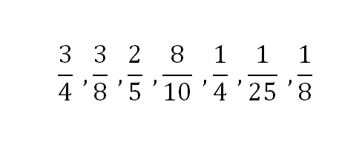
Write down these fractions in order of size from smallest to largest. Explain your method.

Slide 35
Working in groups
Using card sets A, B, C and D
Match pairs of cards
If you need help ask teacher for cards E and F

Slide 36
Place cards in order of size, smallest to largest.

Slide 37
Look back at your original exercise, did you make any mistakes?

Slide 38
Number Operations
N2

Slide 39
Number operations
Complete sheet 1:
Put it aside for now.

Slide 40
Poster exercise
Divide your poster into three columns,
Always true/ sometimes true/ never true

Slide 41
Understanding the laws of arithmetic
N5

Slide 42
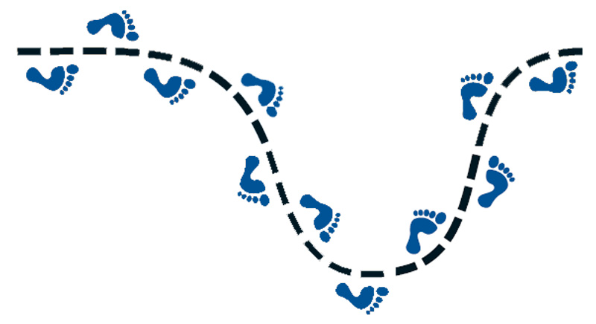
Next Steps…

Slide 43
Provisional Date for Next Session: Thursday 23rd April
Teacher Reflection Sheets
Schoology Reminder
Starting Activities Early
Familiarise with Technology
Comparison Results for FaSMEd
Activities are Guidelines not Rules
Formative Assessment in the Classroom is Key!

