Slide 1
STUDENTS BECOMING ASSESSORS
FaSMEd PROFESSIONAL DEVELOPMENT MODULE

Slide 2
Activity A: Learning from sample responses (1)
When watching the video of Sheena’s lesson (based on the activity in Handout 1) consider the following questions:
What aspects of the provided samples of work do students attend to?
What criteria do students use as they assess the sample work?
What are students learning from the sample work?

Slide 3
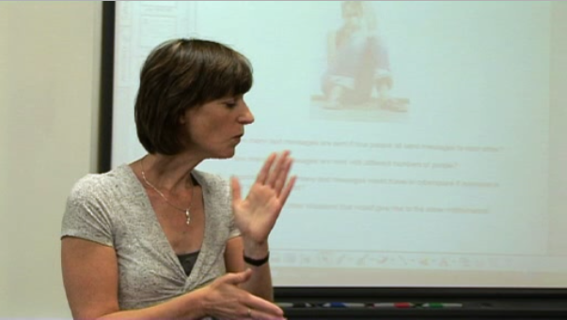
Activity A: Learning from sample responses (2)
Video: Sheena‘s class

Slide 4
Activity A: Learning from sample responses (3)
Concerns about using student work:
Students find it difficult to get started
Students concentrate on neatness of the sample rather than the quality of reasoning,
Students will uncritically copy sample work.
How did Sheena orchestrate the lesson to promote engagement and discussion?
What could you do to avoid potential problems when your students assess other students’ work?

Slide 5
Activity A: Learning from sample responses (4)
Choose a topic or lesson that you have recently taught or planned:
What specific examples would be useful?
Why would they be useful?
What criteria would you use for choosing sample work to use with students?
How would you introduce the activity?
What would you look out far as you circulate?

Slide 6
Activity B: Involving students as assessors (1)
When watching the video of Emma’s and Shane’s lessons (based on the activities in Handout 2 and 3) consider the following questions:
What observations do students make about each other’s work?
How might this help them to improve their own work?
(answer on Handout 4)

Slide 7
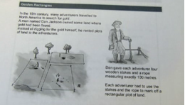
Activity B: Involving students as assessors (2)
Video: Emma‘s and Shane‘s lessons

Slide 8
Activity B: Involving students as assessors (3)
The last pages of Handouts 2 and 3 show the progression steps that were used by Emma and Shane.
What are the advantages and disadvantages of each of Emma’s and Shane’s ‘progression steps’?
(Answer this question on Handout 4)

Slide 9
Activity C: Planning a lesson (1)
Plan a lesson in which students solve a problem, revisit it and assess other students’ work.
Handout 5: Track A:
Students assess work from their own classmates.
Handout 6: Track B:
Students assess sample responses provided by you.

Slide 10
Activity C: Planning a lesson (2)
You might want to consider the following issues (make notes on Handout 7):
Allow students time to work on the assessment task
Opportunities for students to think about their own and others’ work
Time for students to revise their own work in the light of the comments and discussion
Materials needed
Gaining insight into your students’ thinking
Potential difficulties arising and how to react or prevent

Slide 11
Activity D: Exchanging experiences
After teaching the lesson you planned, discuss the following questions from Handout 8:
How did your students perform on the task, unaided?
What were their strengths and difficulties?
How did students assess the provided responses/ work of their peers? What aspects did they attend to? How did they formulate feedback?
How well did students react to and use the evidence to improve their own work?
What are the implications of this lesson for your future teaching?

