Slide 1
Working with the Digital Assessment Environment FaSMEd Meeting 2

Slide 2
Programme
Evaluation Percents and Fractions
Ahead with the DAE
- Metric system
- Graphs
Next steps

Slide 3
Discussion Percents and Fractions
Responses of students after completing the tests?
When you checked the results, what did you notice first ?
What went well? What was difficult?

Slide 4
Discussion Percents and Fractions
What did you learn from the results?
What have you done with it , or are you going to do with it?
Test B?
Questions and ideas for use?

Slide 5
Metric
What does this consist of?
Not: measuring as an activity
But how the various units of measurement relate: the metric system.
What are your teaching experiences with the metric system ?

Slide 6
1 F and 1 S: have at the ready
 | Is equal to:
1 km | 1000 m
1 m | 10 dm
1 dm | 10 cm
1 m | 100 cm
1 cm | 10 mm

Slide 7
Relations between some standard measurement units
km → m → dm → cm → mm
l → dl , cl, ml
kg → g → mg
Dutch reference level 1F: primarily from larger units to smaller units (in meaningful situations)
Dutch reference level 1S: also from smaller units to larger units, and working with decimal numbers (also without a situation)

Slide 8
1F and 1S: knowing your facts
1 dm³ = 1 litre = 1000 ml (for reference level 1F)
1 m³ = 1000 litres (for reference level 1S)

Slide 9
Core competencies metric system
Core competency | Test A | Toets B
Converting measures of weight: g, kg | Problem 1 Click what is more: 5 kg or 7000 grams. How many grams is the difference? ... grams | Problem 1 A shopping bag weighs 3 kg. 40 grams are added. How many grams does the bag weigh now? ... grams
Converting measures of length: cm, dm, m, km | Problem 2 The height of a crate is 60 cm. A pile of five of these crates is … meters high. | Problem 2 A window is 2 m and 4 dm high. How many centimeters is the height of the window? ... cm
 | Problem 3 A sports field is 50 meters wide and 150 meters long. How many kilometers ran the students after 10 laps? ... km | Problem 3 A sports field is 40 meters wide and 60 meters long. After how many laps did the students run exactly 4 km? After ... laps
Converting measures of area: m², cm² | Problem 4 Click what is bigger: a terrace of 10 m² or a terrace of 800 dm². How many dm² is the difference? ... dm² | Problem 4 How many m² of tiles are needed to make a terrace of 50 dm wide and 60 dm long? ... m²
Converting measures of volume: dm³, cm³, liter, dl | Problem 5 Click which tank can hold the most: a tank of 30 liters or a tank of 28 dm³. How many deciliters is the difference? … deciliters | Problem 5 Click which tank can hold the most: a tank of 4000 milliliters or a tank of 10 dm³. How many deciliters is the difference? ... dl
Converting liter, dl, cl, and ml | Problem 6 One glass can 200 ml of lemonade. There are 3 liters of lemonade. How many glasses can you fill? … glasses | Problem 6 A bottle can hold 150 milliliters of perfume. A container contains 6 liters of perfume. How many bottles can be filled with this? ... bottles

Slide 10
Graphs
Common topic in FaSMEd project: time-distance graphs.
Not a regular component of the mathematics curriculum in primary education (in the Netherlands).
Test show what students already know and are capable of without instruction.

Slide 11
Time - distance
Conclusions possible about speed
Speed is a rate, a special ratio between two related measurements (so many km in so many hrs) expressed as one number.
For example, 100 km/h

Slide 12


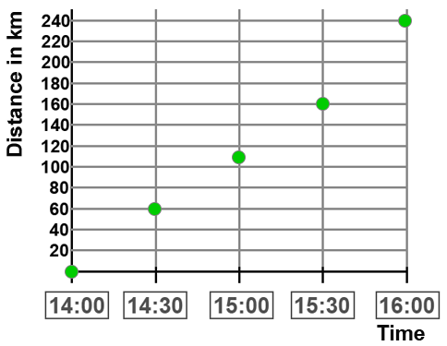
Graphs in DAE
From visualisation:
To scheme:
To graph:

Slide 13
Core competencies graphs
Core competency | Test A | Test B
Pictorially represented data: Drawing conclusions about speed for various distances that have been covered in the same amount of time | Problem 1 (see manual) | Problem 1 (see manual)
Schematically presented time-distance schedule: Drawing conclusions about speed for fixed equal distances that have been covered in varying amounts of time | Problem 2 (see manual) | Problem 2 (see manual)
Schematically presented time-distance schedule: Drawing conclusions about the speed for varying distances that have been covered in fixed time slots | Problem 3 (see manual) | Problem 3 (see manual)
Completing a time-distance graph based on a schematically presented time-distance schedule in which the covered distances and needed time intervals are given | Problem 4 (see manual) | Problem 4 (see manual)
Reading data from a time-distance graph and making the corresponding schematic time-distance schedule | Problem 5 (see manual) | Problem 5 (see manual)
Using the verbal description of travel times and covered distances for making the corresponding time-distance graph | Problem 6 (see manual) | Problem 6 (see manual)
Drawing conclusions about speed based on a time-distance graph | Problem 7 (see manual) | Problem 7 (see manual)

Slide 14
How to continue?
Complete tests metric system and graphs
Last meeting

Slide 15
Next meeting
Evaluation Metric sytem
Evaluation Graphs
General evaluation
Information about further use of the DAE
How to proceed?

Slide 16
Important dates
Week number | Date | 1st FaSMEd meeting
… | … | Completing Test A percents
… | … | Completing Test A fractions
… | … | 2nd FaSMEd meeting
… | … | Completing Test A metric system
… | … | Completing Test A graphs
… | … | 3rd FaSMEd meeting

Slide 17
Finally
Questions/problems progress? Send an e-mail to
<your e-mail address>
Questions/problems DAE? Send an e-mail to
M.J.Abels@uu.nl (Mieke Abels)

Slide 18
Colophon
This PowerPoint was designed by
Ilona Friso-van den Bos, Mieke Abels & Marja van den Heuvel-Panhuizen
Freudenthal Group, Faculty of Social and Behavioural Sciences
Freudenthal Institute, Faculty of Science
Utrecht University

