Slide 1
Working with the Digital Assessment Environment FaSMEd Meeting 3

Slide 2
Programme
Evaluation Metric system and Graphs
Formative assessment: evaluation
Last points of interest

Slide 3
Evaluation of Metric system and Graphs
Responses of students after completing the tests?
What did you learn from the results?
What have you done with it , or are you going to do with it?

Slide 4
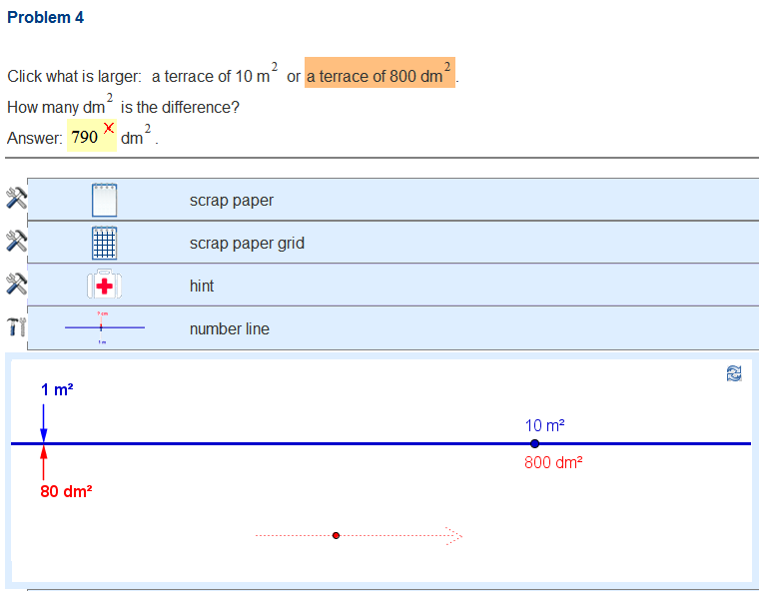
Metric system

Slide 5
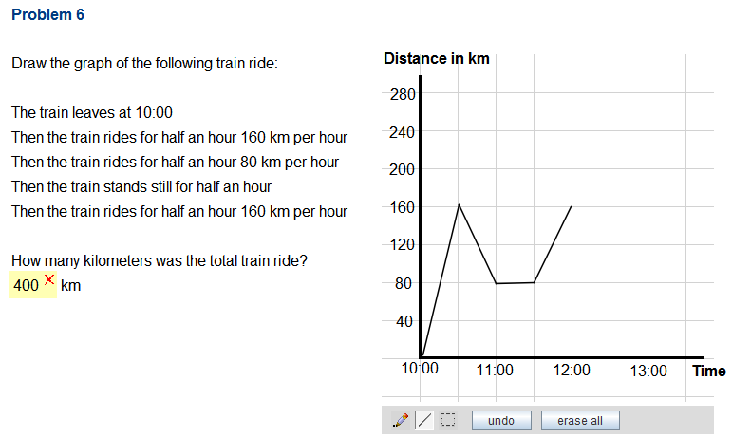
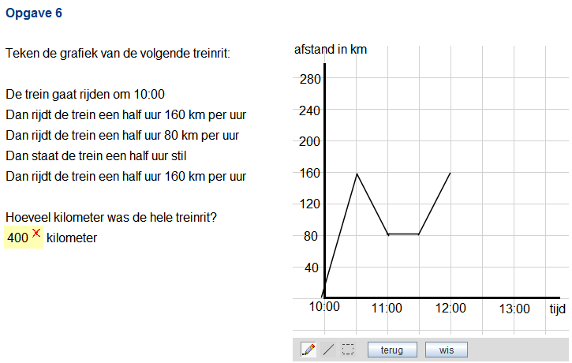
Graphs

Slide 6
Evaluation Metric system and Graphs
Questions and ideas for use?

Slide 7
Evaluation
What was useful?
What was not useful?
Ideas for further development?
Use DAE in other classes?

Slide 8
Finally
Questions/problems progress? Send an e-mail to
<your e-mail address>
Questions/problems DAE? Send an e-mail to
M.J.Abels@uu.nl (Mieke Abels)

Slide 9
Colophon
This PowerPoint was designed by
Ilona Friso-van den Bos, Mieke Abels & Marja van den Heuvel-Panhuizen
Freudenthal Group, Faculty of Social and Behavioural Sciences
Freudenthal Institute, Faculty of Science
Utrecht University

