Slide 1

Guide Steps to success
FaSMEd
A0
Experiments are an important scientific method to find out new things. An experiment is handled in a specific order.
With these diagnostic cards you can work step by step through the experiment.
Start now by pressing the arrow and selecting the first step!
Otherwise you can also skip sub-steps and go to the step where you need help. Therefore you can find the experiment steps after the arrow.

Slide 2

Guide Steps to success
FaSMEd
A0
Start with the first step or skip to the step where you need help.
How do you want to proceed?
Click on the logo to get back to this card anytime.
Propose a hypothesis.
2. What are my experimental approaches?
3. What do I want to observe?
4. Plan an experiment.
5. Did I achieve reasonable results?
6. Draw conclusions.
7. Create a diagram.

Slide 3
EXPERIMENT Can I propose a hypothesis to the given problem?
FaSMEd
A1
Read the story again on the worksheet.
Propose a justified presumption (hypothesis) for the stated problem. Write it down in your experimental protocol.

Slide 4
Solution
FaSMEd
A1
For this specific problem you can propose the hypothesis in various ways.
(It doesn’t matter if your hypothesis turns out to be wrong at the end of the experiment.)
How did you proceed?
I didn’t know what to find out. (A1.2)
I’ve set up a scientific presumption.
(A2)
I was unable to propose any scientific presumption. (A1.1)

Slide 5
EXPERIMENT What are the experimental approaches?
FaSMEd
A2
After your first scientific presumption you may now design your experiment.
For your first preparations you need two experimental approaches:
If X is present, then something happens.
If X is not present, then something different happens.
Afterwards the different results of your experiment will show you the effect of this factor X.
Which one is your chosen variable in this experiment?

Slide 6
Solution
FaSMEd
A2
The important variables in this experiment are:
.
skin available/ not available whole apple or apple in pieces weight in gram temperature | apple variety light air flow initial weight
Which variable did you choose?
Light – varied as intense/ not intense. (A2.1)
Skin – varied as available/ not available. (A2.2)
Size of the pieces- varied as whole apple/ bite-sized pieces. (A3)
I’ve chosen one of the other variables as independent variables. (A2.3)

Slide 7
EXPERIMENT What do I want to observe?
FaSMEd
A3
You now have two experimental approaches. One approach has got the chosen variable, the second doesn’t. Now you want to observe, for example, for 8 minutes the effects of these two experimental approaches.
What do you want to observe in your experiment to check your scientific presumption?

Slide 8
Solution
FaSMEd
A3
The following aspects can be observed during the experiment:
skin available/ not available whole apple or apple in pieces weight in gram temperature | apple variety light air flow initial weight
Which effects can you observe?
Light – varied as intense/ not intense. (A3.1)
Initial weight measured in gram. (A3.2)
Weight measured in gram. (A4)
I will see other effects in my experiments(A3.3)

Slide 9
EXPERIMENT Can I plan an experiment?
FaSMEd
A4
You now have all the necessary information to plan your experiment:
You know, what has to be present/ not present in the two different experimental approaches.
You know, what you have to observe to check your scientific presumption.
You should now plan an experiment, where you can check your scientific presumption.
Make notes for your experimental setup and procedure.

Slide 10
Solution
FaSMEd
A4
The experimental setup should contain all necessary materials and quantities that you will use in your experiment.
The experiment procedure describes the procedure of the experiment in individual steps (What do you do with your materials?). Imagine you are writing a “cooking recipe”.
After you have listed your ideas for setup and procedure you can continue with A5.
A5

Slide 11
EXPERIMENT Did I achieve reasonable results?
FaSMEd
A5
Perform the experiment and record your data in a table. Then look at your results.

Slide 12
Solution
FaSMEd
A5
Compare your results with the given data below from a comparable experiment.
Time (in minutes) | Weight (in gram)
 | Unpeeled | Peeled, cut into pieces
0 | 160 | 158
1 | 158 | 154
2 | 155 | 148
3 | 154 | 146
4 | 153 | 143
5 | 151 | 139
6 | 149 | 138
7 | 149 | 138
8 | 149 | 138
What differences can you notice?
My results do not change or change rapidly. (A5.1)
My results have a different arrangement than the given above. They are much higher/lower or the values don’t increase evenly. (A5.2)
My experimental results are similar to the given above. (A6)

Slide 13
EXPERIMENT Can I draw conclusions from the data?
FaSMEd
A6
Look at your results. Can you confirm the initial hypothesis with these results?

Slide 14
Solution
FaSMEd
A6
The determined data from your experiment can now help you to draw conclusions for your hypothesis. Therefore it is important to visualize the data and look for relations between each entry.
For this purpose you create a diagram in the next steps which helps you to represent the collected data clearly and compactly.
Now go to A7.
A7

Slide 15
DIAGRAM Can I find a suitable diagram type?
FaSMEd
A7
Now you should transfer the measured data into a diagram. Because the connections and changes are visualized, the evaluation of the data gets simplified.
What diagram type is suitable for this situation?

Slide 16
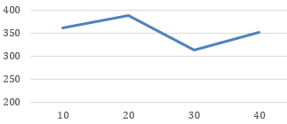
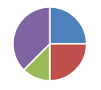
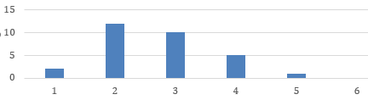
Solution
FaSMEd
A7
There are different types of diagrams. Some of them are better to present certain facts and situations than others.
Which diagram type did you choose?
Line graph
(A7.1)
Pie chart
(A7.2)
Column/ bar chart
(A7.3)

Slide 17
DIAGRAM Can I assign the variables to the exes?
FaSMEd
A8
It is important that the experiment variables are correctly assigned so that your classmates can easily read the data values out of your graph.
Which axis is assigned with the time, and which one is assigned with the measured effects?

Slide 18
Solution
FaSMEd
A8
How did you label your axes?
I assigned the time to the x-axis. (A8.1)
I assigned the time to the y-axis. (A9)
I’ve chosen a different assignment. (A8.1)

Slide 19
DIAGRAM Can I label my axes correctly?
FaSMEd
A9
In order to understand your diagram without any additional information, it is important that the axes of the diagram are labeled clearly.
How would you label the axes in your diagram?

Slide 20
Solution
FaSMEd
A9
There are many ways to label the axes. It’s important that besides the name the unit is labeled to the axis.
Which label did you choose?
X: „weight“, Y: „time“ (A9.1)
X: „time“, Y: „weight“ (A8.1)
X: „The weight of the apple“,
Y: “ Depending on time“ (A9.1)
X: „weight [g]“, Y:“time [min]“ (A10)
I’ve chosen different labels. (A9.1)

Slide 21
DIAGRAM Does the diagram has an appropriate scaling?
FaSMEd
A10
A simple diagram should include all necessary information so the reader can read the diagram easily and without additional information.
How should you choose the scaling to provide a clear and structured diagram?

Slide 22
Solution
FaSMEd
A10
For a suitable scaling it is important that you clarify what distances are plotted between the individual data points on the graph axes. Furthermore the diagram shouldn’t be too small or too large to make an easy reading possible.
If you have drawn a suitable scaling on the graph axes go to A11.
A11

Slide 23
DIAGRAM Can I plot the data in a chart?
FaSMEd
A11
Enter the individual data from your experiment into your previously selected diagram type. Pay attention to the axis labeling and scaling.

Slide 24
Solution
FaSMEd
A11
In this experiment the line graph is the most appropriate diagram type. The questions you have to ask are:
How do I enter my measured points?
How do I connect the individual points?
How did I solve the problem?
My diagram starts at zero. (A11.1)
I’ve created three individual diagrams. (A11.2)
I’ve connected the data points of each individual experimental approach. (A12)
I’ve interconnected all data points. (A11.3)
I didn’t connect the data points. (A11.3)
I was unable to plot the data points into the diagram. (A11.4)

Slide 25
GOAL
FaSMEd
A12
You are almost done! Finally, use your diagram to check if you initial hypothesis can be confirmed.
The diagram shows which approach leads to which result.
Can you explain the differences?

Slide 26
Solution
FaSMEd
A12
In this experiment we investigated whether the bite-sized apple pieces can cause a faster water evaporation than the whole apple.
a) What did you find out? Compare the results of the different experimental approaches.
b) Do you have any presumptions?
Hint?!
Ende

Slide 27
GTK
FaSMEd
A1.1
A hypothesis is a testable statement, which can be checked in an experiment.
To test a hypothesis you have to check the relation between two variables.
A scientific presumption should be forumulated like that:
If X is present, then something happens.
If X is not present, then something different happens.
Before you examine a relation between the variables in an experiment, you have to set a scientific presumption.

Slide 28
GTK
FaSMEd
A1.2
Eexample:
Imagine you are getting a cut apple from your mother to school. Unfortunately you forgot to eat it so you find the apple after a week in your schoolbag. Now the apple pieces are shriveled and collapsed. They also lost weight. This process has already begun on the first day. Sometimes it’s difficult to discover these differences in the first few minutes.
The scale helps to determine the weight repeatedly. Please note that the scale must be set correctly.

Slide 29
GTK
FaSMEd
A2.1
You can only draw conclusions from your observations, if you change the chosen variable consciously.
Read the story again. The question is: Which child (Bahri or Sandra) will probably enjoy the juiciest apple in the afternoon? The apples differ in their sizes: Bahris’s apple is peeled and Sandra’s apple is peeled and cut into bite-sized pieces.
The light comes mostly from the sun. This is likely to be the same for all students on their excursion. Keep this in mind for your experiment!

Slide 30
GTK
FaSMEd
A2.2
Read the story again.
Bahri’s apple is peeled, Sandra’s apple is peeled and cut into bite-sized pieces.

Slide 31
GTK
FaSMEd
A2.3
Variable X is changed consciously under controlled conditions.
The apple variety, the initial weight, the temperature and the air flow should be kept constant. If they change, they would impact the experiment and the results.
Read the situation again. The question is: Which child will probably enjoy the juiciest apple in the afternoon? The apples differ in their size. Bahri’s apple is peeled, Sandra’s apple is peeled and was cut into bite-sized pieces.

Slide 32
GTK
FaSMEd
A3.1
With the help of your experiment you will get results which can be measured.
Hint:
The light intensity depends on the sun and is likely the same for all students on their excursion.

Slide 33
GTK
FaSMEd
A3.2
With the help of your experiment you will get results which can be measured.
The weight of the apple will change during the experiment. Only the weight at the beginning is called „initial weight“.

Slide 34
GTK
FaSMEd
A3.3
With the help of your experiment you will get results which can be measured.
The apple variety, the initial weight, the temperature and the air flow should be kept constant. If they change, they would impact the experiment and the results.
The requested variable is the size of the apple pieces. What happens with the apple pieces during the experiment and what changes can you measure?

Slide 35
GTK
FaSMEd
A5.1
Example:
Imagine you are drinking out of a water bottle. After each sip you measure the bottle weight in grams. A sip of water weighs about 3g. Therefore the water bottle loses 3g after each sip. Now compare the exact and the rounded data of this experiment:
As you may notice in the table, the rounded values display the same values several times, even though you have been drinking from the water bottle. Therefore it’s important to write down the measurements accurately to make even small changes visible.
 | 0 sip | 1 sip | 2 sips | 3 sips | 4 sips | ...
Exact | 500 g | 497 g | 494 g | 491 g | 488 g | …
Rounded | 500 g | 500 g | 490 g | 490 g | 490 g | …

Slide 36
GTK
FaSMEd
A5.2
a) In order to compare the results, it’s important to collect them under the same conditions. Therefore you have to remove the weight of the petri dish from the measured weight to achieve proper results.
b) For precise and clean working it is important to weigh the apple on a petri dish. It is useful to weigh the petri dish before the experiment and subtract this weight from the determined total weight of each measurement. Thereby you can determine the weight of the apple itself.

Slide 37
GTK
FaSMEd
A7.1
A line graph illustrates the (time-dependent) course of items. If the measured items are interdependent you can connect them to a line.
Example:
A8

Slide 38
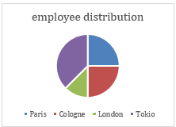
GTK
FaSMEd
A7.2
A pie chart illustrates the ratio and proportions of data by representing the ratio of a single value to the total.
Example:
Note: Look at your listed values. They don’t show values or shares. They display the time in correspondence with the weight of the apple pieces.

Slide 39
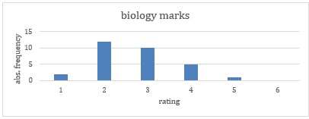
GTK
FaSMEd
A7.3
A column chart is used to compare the values among themselves by displaying the quantitative frequency as columns. If you turn the column chart by 90 degrees, you get a bar chart.
Example:
Note: A column or bar chart only displays the overall change. However in this experiment it’s important to present the progression over time.

Slide 40
GTK
FaSMEd
A8.1
Remember planning your experiment? You’ve set up two different experimental approaches: In one approach the variable is present, in the other the variable is not present. Because we summarize both experimental approaches in one chart, we investigate the effects of the time on the weight of the apple.
If you would like to investigate the temporal course, you represent it in reading direction: You arrange the time on the horizontal axis (from left to right) and the measured characteristic (for example: weight) on the vertical axis (from bottom to top).

Slide 41
GTK
FaSMEd
A9.1
In order to interpret the diagram correctly it’s important that the labeling is clear, unambiguous and complete.
Please note:
A clear diagram should be labeled with short and meaningful words.
e.g.: Instead of „the achieved height when jumping (in meters)“ you should write „jump height [m]“
The reader of the diagram should understand the meaning of the axis labeling immediately. Therefore they should be labeled unambiguous.
e.g.: The axis label „flower“ does not allow any clearly conclusions. Is „diameter“, „color“, „number“ or „size“ intended?
A complete description should include the label and the units of the used variables.
e.g.: Instead of „size“ you should write „size [m]“ or „size [cm]“ in order to make clear in what size units the data were measured.

Slide 42
GTK
FaSMEd
A11.1
Depending on the obtained data in the experiment, the following line chart can arise:
Choosing the graphs’ stating point at zero implies that the apple has a weight of 0 g at the beginning. After this the weight increases to the initial weight before it slowly loses weight again.

Slide 43
GTK
FaSMEd
A11.2
To compare different experimental approaches, we can transfer them in one common diagram under certain conditions.
This requires:
An appropriate diagram type for the representation of several approaches in one diagram.
The same initial conditions for each experimental approach.
The results were obtained in the same units.
The variables for the experiment and the diagram axes are identical.

Slide 44
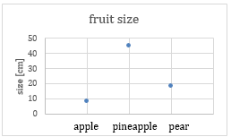
GTK
FaSMEd
A11.3
You can connect the individual data points in a line graph, if the data points are related to each other.
Example:
Note: If you plot several experimental approaches in one diagram, you may only connect the points of one approach.
In this case it’s not allowed to connect the points, because the sizes of the different fruits are not interdependent.

Slide 45
GTK
FaSMEd
A11.4
How can I plot the measured data into a line graph?
1) Each data point consists of two values. In this case the values are the time and the measured weight at this time.
Example: If you have determined the apple weight of 280 grams one minute after the experimental beginning, you get the data point ( 1 / 280 ).
2) Now you can use the created axes to find the position in the line graph: The first value specifies the x-axis position, the second value specifies the y-axis position.
Example: The data point ( 1 / 280 ) is drawn by „going“ 1 unit in x-axis direction and 280 units in y-axis direction.
HINT

Slide 46
Definition
FaSMEd
Hypothesis (also called scientific presumption):
A hypothesis is a testable statement, which you want to check in an experiment.
It describes the conditions under which your assumption is valid.
A hypothesis is mostly written in an “if-then-form”. This means:
If a condition is fulfilled, then something happens.

Slide 47
Definition
FaSMEd
Problem:
A problem is a summarizing description of a situation in one to two sentences.
To what question does this situation lead?

Slide 48
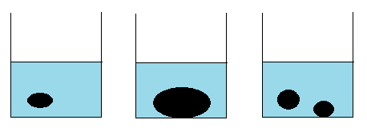
Definition
FaSMEd
Experimental approach:
Each experimental approach is part of the experiment.
In this illustration you can see an experiment which consists of three experimental approaches.

Slide 49
Definition
FaSMEd
Factor (or variable):
A factor or variable is a certain condition or part of the experiment, you would like to change. Everything that has something to do with your experiment is a factor of the experiment.
Example: the light intensity, the heat supply, if the sin is present or not, the size of the apple pieces, …

Slide 50
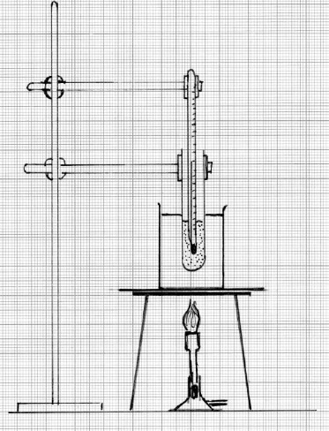
Definition
FaSMEd
Experimental setup:
An experimental setup describes how your experiment looks like. You can do this for example with a sketch.
Therefore you have to draw the equipment and the materials and how they are placed for the experiment exactly .

Slide 51
Definition
FaSMEd
Experimental procedure:
In the experimental procedure you describe how you proceed in your experiment exactly. Imagine you are writing a cooking recipe.

Slide 52
Definition
FaSMEd
Measured results (also called measured data):
The measured result is the value you observed in your measurement.
Example: If you have to weight something and the scale indicates 65 g, your measured result is 65g.
If you have multiple measured results, you can represent them in a table.

Slide 53
Definition
FaSMEd
„clearly and compactly“:
Clearly means that you should display the data in a way so that your classmates and teachers can understand and imagine your description.
Compactly means that you should display the data concisely, not with too much details.

Slide 54
Definition
FaSMEd
Evaluation:
The evaluation of an experiment or the analysis of the data is also called interpretation.
Therefore you link the gathered information with your knowledge. Afterwards you develop a justification to draw conclusions about your hypothesis.

Slide 55
Definition
FaSMEd
Scaling:
Scaling is a fixed step size to get all numbers on your chart. Imagine you are using a magnifying glass.
If you want to get the numbers from 0 to 100 on this page for example, it is hard when you write down all the numbers.
0 1 2 3 4 5 6 7 8 9 10 11 12 13 14 15 16 ??
Unfortunately the number 100 doesn't fit on the numbers line. Therefore you choose a small step size (=scaling) of the numbers, hence the 100 can be seen:
0 25 50 75 100

Slide 56
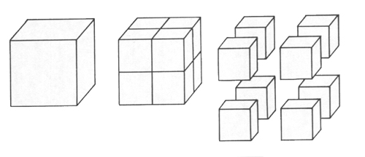
Definition
FaSMEd
Hint:
Small sliced apple pieces have a larger (“vulnerable”) surface.

Slide 57
Definition
FaSMEd
Initial weight:
The initial weight is the weight of an object at the start of the experiment.

Slide 58
Definition
FaSMEd
Constant:
Referring something as constant means that it does not change during the procedure of the experiment. Its value remains the same all the time.

Slide 59
Definition
FaSMEd
Manipulation:
A manipulation is a conscious alteration of a factor/ variable.

Slide 60
Definition
FaSMEd
Initial conditions:
An initial condition is a condition that exists at the beginning of the experiment. Only if it stays the same during the whole experiment, you can compare the obtained data later.

Slide 61
Definition
FaSMEd
Axis:
An axis is a long line which helps to identify the positions of points.
A horizontal axis is drawn from left to right.
A vertical axis is drawn from the bottom up.
A line graph consists of a horizontal and a vertical axis. The point on the intersection of both axes is zero.

Slide 62
Definition
FaSMEd
Hint:
Here you can see a blank chart, in which the point ( 0 / 280 ) is drawn.

Slide 63

Congratulations! You have completed the task successfully!

