Slide 1
FaSMEd
Lesson at school B March 2015
Micro organisms -
prevent bacteria spreading
The Norwegian FaSMEd group
Emily Coates, Birgit Pepin, Jardar Cyvin, Maria Febri, Øistein Gjøvik, Svein Arne Sikko, Ragnhild Lyngved Staberg, Bente Østigård
This project has received funding from the European Union’s Seventh Framework Programme under grant agreement no 612337

Slide 2
The following lesson is developed with the ideas from the UK internet site http://www.e-bug.eu/junior_pack.aspx?cc=eng&ss=2&t=Respiratory
The pictures, figures and templates for student results are all from this internet site.

Slide 3
Dear Year 6,
I heard you guys are great with Science - I need your help!
I have a bad cold and my Granny says she doesn't want me to give it to her. I don't know what she means, I usually give her flowers!
Anyway, I wondered if you can help? My Granny is certain that she will catch my cold. Is there anything I can do to stop this happening?
Yours sincerely,
Bob

Slide 4
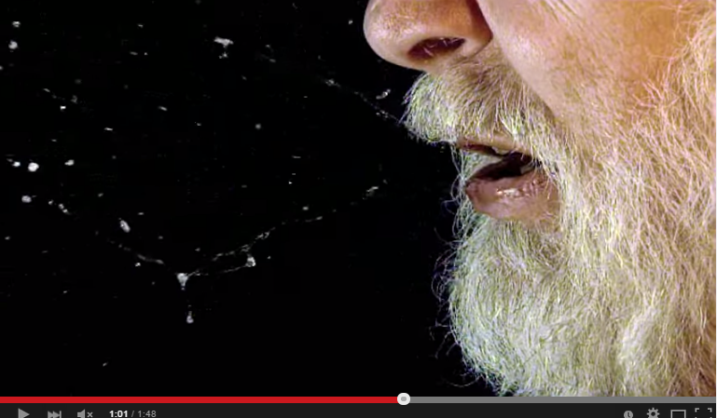
What does Bob mean when he says Granny doesn't want him to 'give me a cold'?
Are there any other words or phrases we use when we talk about illnesses spreading? Talk to a friend - 1 minute!
What are we really doing when we 'catch a cold'?

Slide 5
What kind of things do people do to try to stop micro-organisms such as the cold or flu virus spreading?
We are going to investigate which is the best way to stop a sneeze travelling.
Stick your post-it note next to the method you think is best.

Slide 6
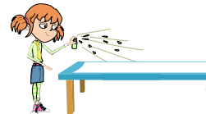
Groups today
aaaa, bbbb, cccc
dddd, eeee, ffff
gggg, hhhh,iiii, jjjj
kkkk, llll ,mmmm, nnnn
oooo, pppp, qqqq, rrrr
Jobs:
runway layer, sprayer, measurer, recorder
tidier (2)

Slide 7
Each group needs to make a 'sneeze runway' using paper towels.
You are going to measure how far a sneeze travels:
- on its own
- with a hand in front (use the glove!)
- with a tissue
- with an elbow

Slide 8
Group number | no protection | hand | tissue | elbow
1
2
3
4
5

Slide 9
Graph to show distance travelled by a sneeze using different types of protection
elbow
method of protection
tissue
hand
no protection
distance travelled

Slide 10
Log on to Socrative and join the room:
123456789
Answer the questions at your own pace.

Slide 11
On your paper, write a letter back to Bob.
You will need to:
- explain what his Granny means by 'giving a cold'
- explain how micro-organisms are spread when you have a cold
- tell him what he should do to help stop his cold spreading after your experiment
- tell him anything else you know that he can do to prevent his cold spreading

