Slide 1
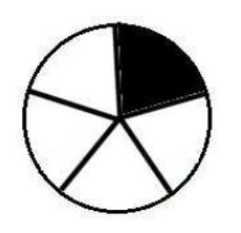
Which fraction does correspond to the coloured part?
1/4
1/5
5/1

Slide 2
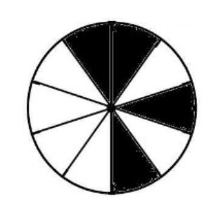
Which fraction does correspond to the coloured part?
4/10
4/6
6/10

Slide 3
Which fraction does correspond to the coloured part?
2/2
2/1
1/2

Slide 4
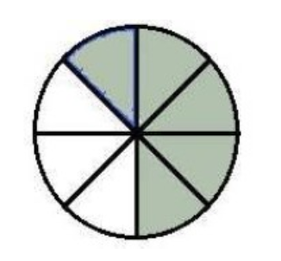
Which fraction does correspond to the coloured part?
5/3
5/8
3/5

Slide 5
Which fraction does correspond to the coloured part?
7/10
7/3
3/7

Slide 6
Which fraction does correspond to the coloured part?
2/6
1/3
1/2

Slide 7
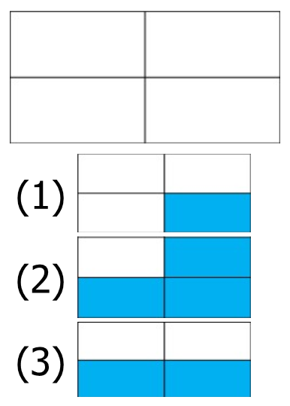
Colour the fraction 3/4

Slide 8
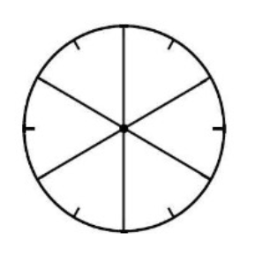
Colour the fraction 4/6
I colour 4 parts
I colour 2 parts
I colour 6 parts

Slide 9
Colour the fraction 1/2

Slide 10
Colour the fraction 3/10

Slide 11
Write the fraction 3/2 in letters
Three halves
Three seconds
Two thirds

Slide 12
Write the fraction 12/4 in letters
Twelve quarters
Twelve fourth
Twelve fours

Slide 13
Write the fraction 2/5 in letters
Two five
Two fifths
Five seconds

Slide 14
Write the fraction 4/3 in letters
Four thirds
Four third
Four three

Slide 15
Write the fraction 7/8 in letters
Seven eights
Eight seventh
Seven eighths

Slide 16
Give the fractional writing of two thirds
3/2
2/30
2/3

Slide 17
Give the fractional writing of thirty-five fourths
35/2
35/4
4/35

Slide 18
Give the fractional writing of eleven eighths
11/8
11/4
8/11

Slide 19
Give the fractional writing of three halves
3/1
2/3
3/2

Slide 20
Complete the sentence:
In a unit, there are … halves
three
two
one

Slide 21
Complete the sentence:
In a unit, there are … thirds
four
two
three

Slide 22
Complete the equality:
$$\frac{3}{4}= … ×\frac{1}{4}$$
3
2
4

Slide 23
Complete the equality:
$$1= … ×\frac{1}{2}$$
2
1
4

Slide 24
Complete the equality:
$$1=\frac{…}{10}$$
11
1
10

Slide 25
Complete the equality:
$$1=\frac{…}{3}$$
1
3
4

Slide 26
Complete the equality:
$$1=\frac{…}{2}$$
3
1
2

Slide 27
Place the fraction 4/2 on the number line

Slide 28
Place the fraction 3/4 on the number line

Slide 29
Place the fraction 9/2 on the number line

Slide 30
Place the fraction 10/4 on the number line

Slide 31
Place the fraction 7/2 on the number line

Slide 32
Place the fraction 20/4 on the number line

Slide 33
Place on the number line the point A: 1/3

Slide 34
Place on the number line the point B: 3/3

Slide 35
Place on the number line the point C: $1+\frac{2}{3}$

Slide 36
Place on the number line the point D: $9/3$

Slide 37
Place on the number line the point E: $2+\frac{2}{3}$

Slide 38
Write the fraction that corresponds to the point G
5/10
2/5
5/1

Slide 39
Write the fraction that corresponds to the point H
1/3
13/10
13/20

Slide 40
Write the fraction that corresponds to the point I
19/10
9/10
20/10

Slide 41
Write the fraction that corresponds to the point J
6/20
6/10
24/10

Slide 42
Write the fraction that corresponds to the point K
12/10
3/1
30/20

Slide 43
Compare the fractions
$\frac{15}{15}$ and 1
$\frac{15}{15}>1$
$\frac{15}{15}<1$
$\frac{15}{15}=1$

Slide 44
Compare the fractions
$\frac{4}{3}$ and 1
$\frac{4}{3}<1$
$\frac{4}{3}=1$
$\frac{4}{3}>1$

Slide 45
Compare the fractions
$\frac{13}{8}$ and 1
$\frac{13}{8}=1$
$\frac{13}{8}>1$
$\frac{13}{8}<1$

Slide 46
Compare the fractions
$\frac{16}{25}$ and 1
$\frac{16}{25}<1$
$\frac{16}{25}=1$
$\frac{16}{25}>1$

Slide 47
Compare the fractions
$\frac{2}{4}$ and $\frac{7}{4}$
$\frac{2}{4}=\frac{7}{4}$
$\frac{2}{4}<\frac{7}{4}$
$\frac{2}{4}>\frac{7}{4}$

Slide 48
Compare the fractions
$\frac{38}{11}$ and $\frac{23}{11}$
$\frac{38}{11}=\frac{23}{11}$
$\frac{38}{11}<\frac{23}{11}$
$\frac{38}{11}>\frac{23}{11}$

