Slide 1
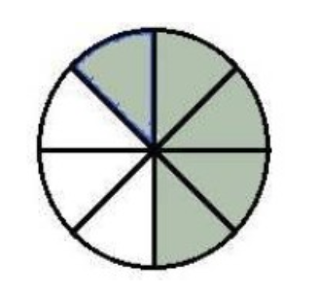
Which fraction does correspond to the coloured part?
5/3
5/8
3/5

Slide 2
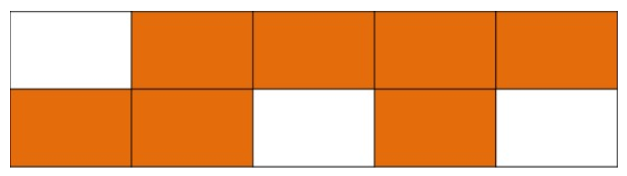
Which fraction does correspond to the coloured part?
7/10
7/3
3/7

Slide 3
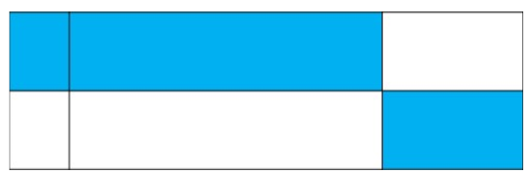
Which fraction does correspond to the coloured part?
2/6
1/3
1/2

Slide 4
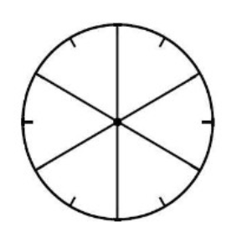
Colour the fraction 4/6
I colour 4 parts
I colour 2 parts
I colour 6 parts

Slide 5
Write the fraction 2/5 in letters
Two five
Two fifths
Five seconds

Slide 6
Write the fraction 7/8 in letters
Seven eights
Eight seventh
Seven eighths

Slide 7
Give the fractional writing of thirty-five fourths
35/2
35/4
4/35

Slide 8
Complete the sentence:
In a unit, there are … thirds
four
two
three

Slide 9

Complete the equality:
$$\frac{3}{4}= … ×\frac{1}{4}$$
3
2
4

Slide 10

Complete the equality:
$$1= … ×\frac{1}{2}$$
2
1
4

Slide 11

Complete the equality:
$$1=\frac{…}{3}$$
1
3
4

Slide 12
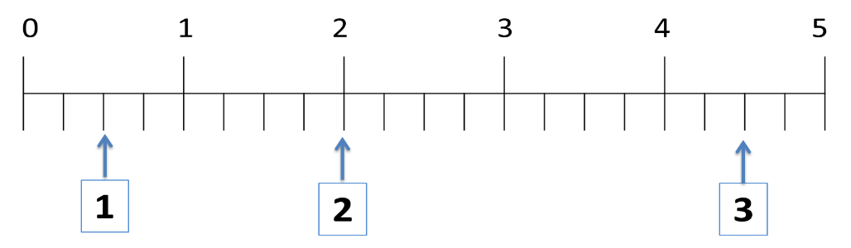
Place the fraction 4/2 on the number line

Slide 13
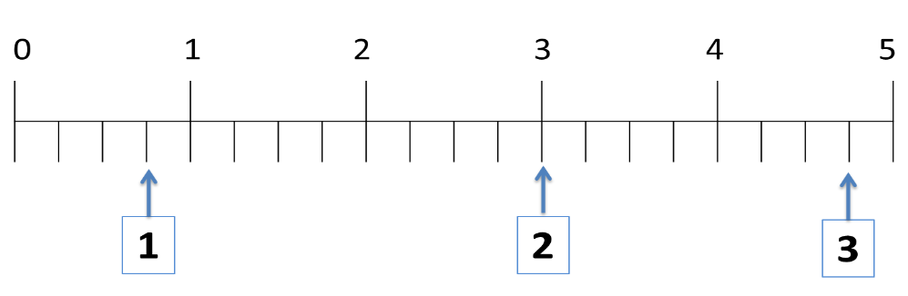
Place the fraction 3/4 on the number line

Slide 14
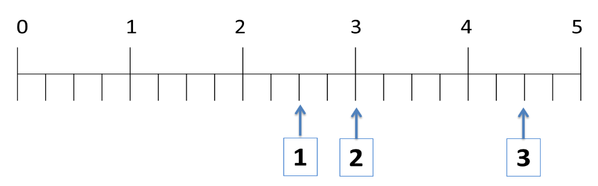
Place the fraction 9/2 on the number line

Slide 15
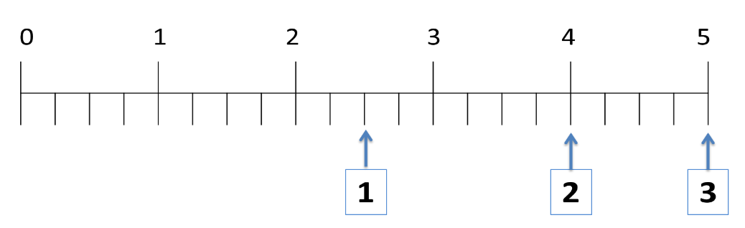
Place the fraction 10/4 on the number line

Slide 16
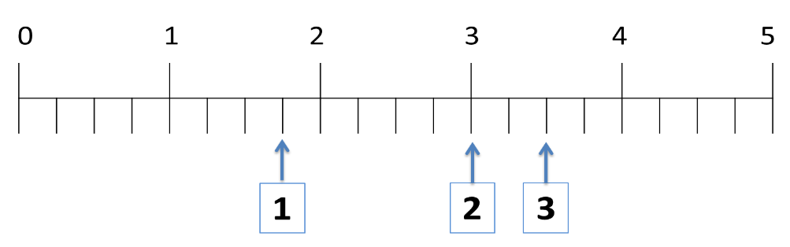
Place the fraction 7/2 on the number line

Slide 17
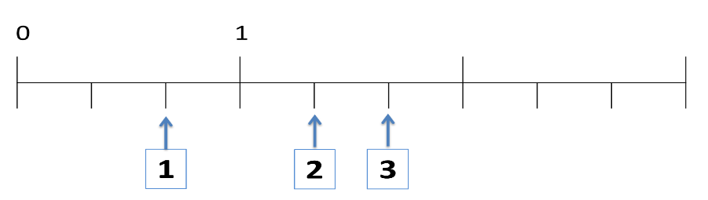

Place on the number line the point C: $1+\frac{2}{3}$

Slide 18
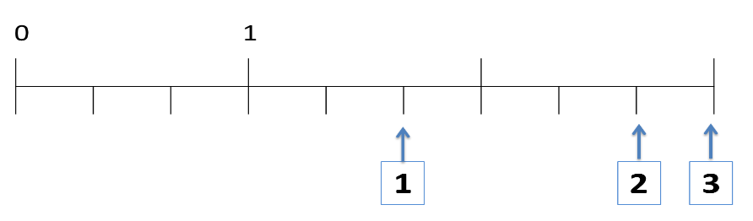

Place on the number line the point E: $2+\frac{2}{3}$

Slide 19
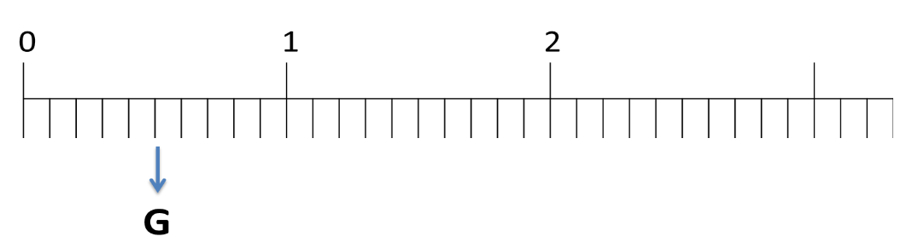
Write the fraction that corresponds to the point G
5/10
2/5
5/1

Slide 20
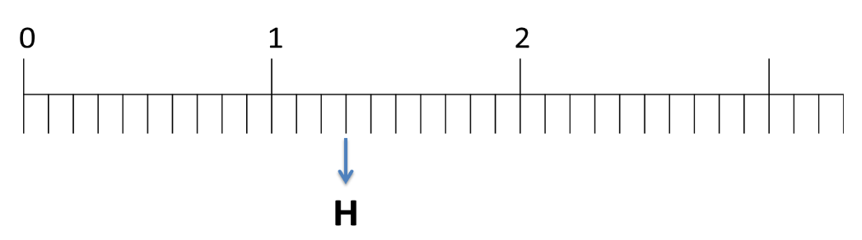
Write the fraction that corresponds to the point H
1/3
13/10
13/20

Slide 21
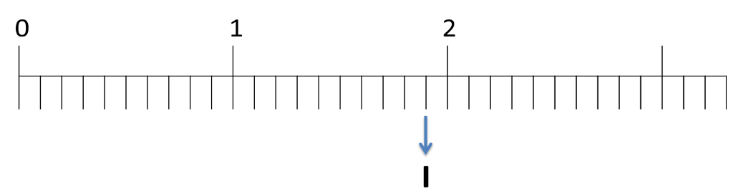
Write the fraction that corresponds to the point I
19/10
9/10
20/10

Slide 22
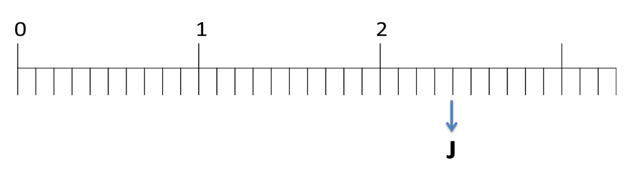
Write the fraction that corresponds to the point J
6/20
6/10
24/10

Slide 23
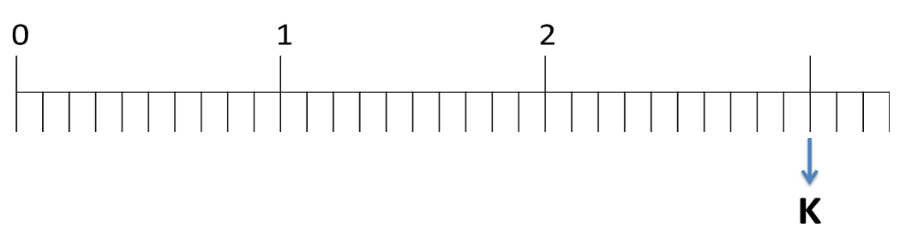
Write the fraction that corresponds to the point K
12/10
30/10
30/20

Slide 24
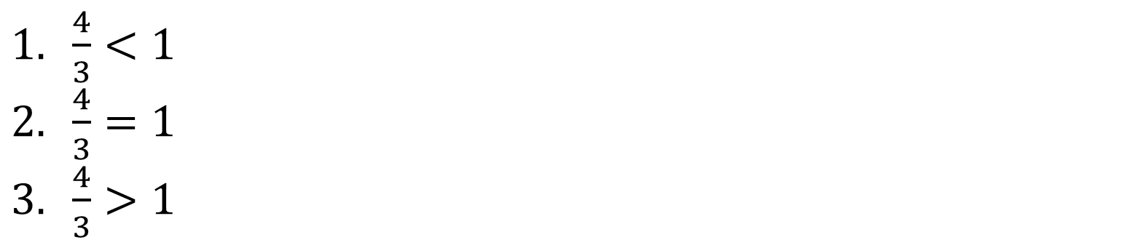

Compare the fractions
$\frac{4}{3}$ and 1
$\frac{4}{3}<1$
$\frac{4}{3}=1$
$\frac{4}{3}>1$

Slide 25
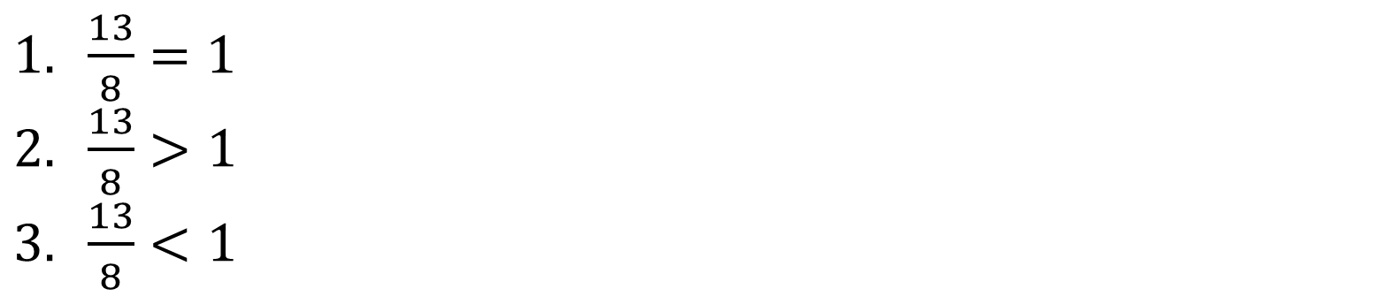

Compare the fractions
$\frac{13}{8}$ and 1
$\frac{13}{8}=1$
$\frac{13}{8}>1$
$\frac{13}{8}<1$

Slide 26
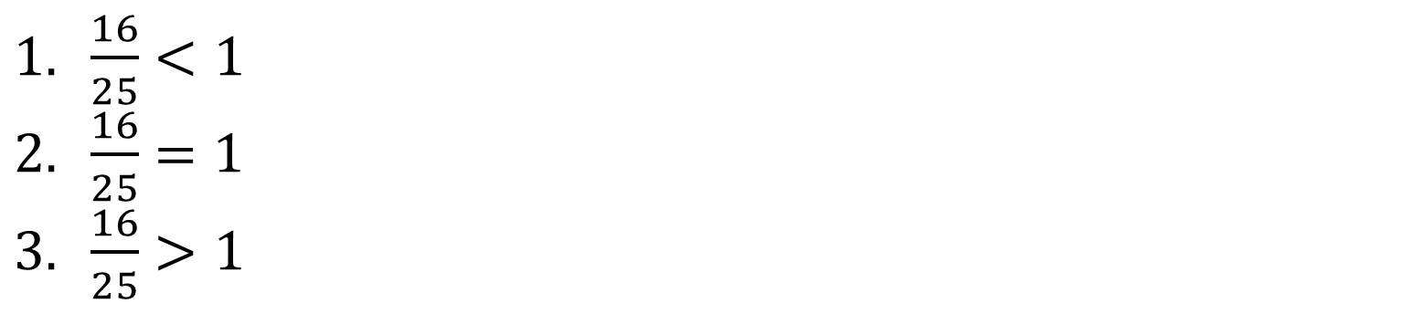

Compare the fractions
$\frac{16}{25}$ and 1
$\frac{16}{25}<1$
$\frac{16}{25}=1$
$\frac{16}{25}>1$

Slide 27
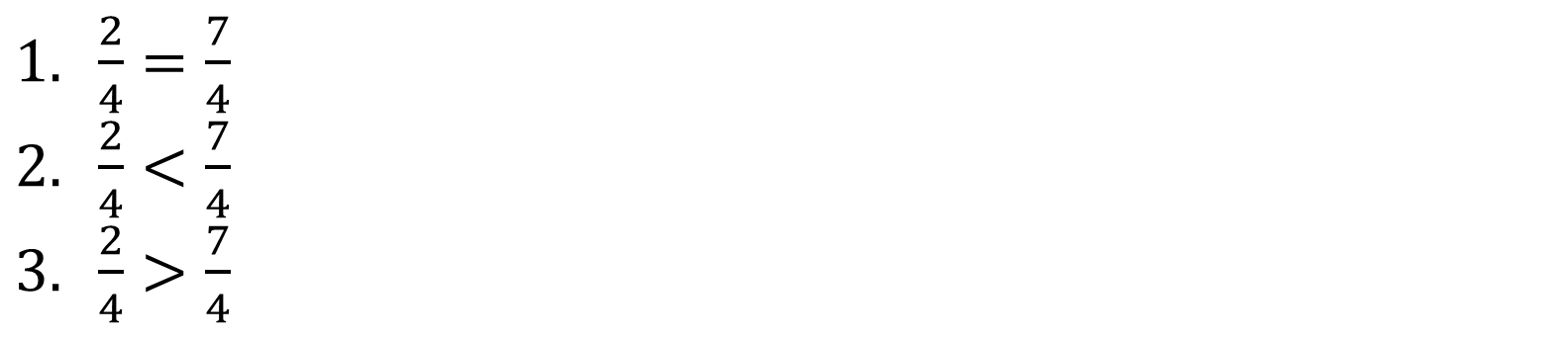

Compare the fractions
$\frac{2}{4}$ and $\frac{7}{4}$
$\frac{2}{4}=\frac{7}{4}$
$\frac{2}{4}<\frac{7}{4}$
$\frac{2}{4}>\frac{7}{4}$

