Slide 1
TECHNOLOGY FOR FORMATIVE ASSESSMENT
FaSMEd PROFESSIONAL DEVELOPMENT MODULE

Slide 2
Activity A: Technology in the classroom (1)
Discuss the questions on Handout 1:
Which technologies are available for use in mathematics/science classrooms?
Which technologies can help you, the teacher, with formative assessment?

Slide 3
Activity A: Technology in the classroom (1)
Around the world, teachers use a wide range of technologies in classrooms. The term technology is often taken to mean digital technology, or computer technology, but it frequently refers to non-digital technologies as well.
Examples of digital technologies:
Computers, tablets, smart phones, calculators;
Projection technology, including interactive whiteboards;
Data logging, dynamic geometry software, computer algebra systems.
Examples of non-digital technologies:
Pens, pencils, chalk;
Paper, mini-whiteboards;
Cuisenaire rods, vernier calipers, counters, playing cards.

Slide 4
Activity A: Technology in the classroom (1)
Fred: “I use ‘traffic lights’ in my classroom. When I ask the children if they understand, they hold up a red light if they don’t understand, an orange light if they are ok, and a green light if they are happy with the concept. Traffic lights are the main technology I use for formative assessment.”
Archie: “We have a set of ‘clickers’. These are quite versatile. The children can enter their answer to one of my questions and all the answers are displayed on the whiteboard. I can quickly see who doesn’t understand. I can also see how many children don’t understand.’
Jane: “I use a range of approaches in my classroom. It’s not about the technology as such, though, is it? It’s about my understanding of what my students are struggling with and what they can do. I suppose almost any technology could help me with that.”

Slide 5
Activity A: Technology in the classroom (2)
"… all those activities undertaken by teachers, and by their students in assessing themselves, which provide information to be used as feedback to modify the teaching and learning activities in which they are engaged. Such assessment becomes ‘formative assessment’ when the evidence is actually used to adapt the teaching work to meet the needs." (Black & Wiliam, 1998 para, 91)

Slide 6
Activity A: Technology in the classroom (3)
Further questions on Handout 1:
How can technologies contribute to the processes of formative assessment?
What is the role of the teacher in formative assessment (when technology is used)?
Suggest better questions to ask!

Slide 7
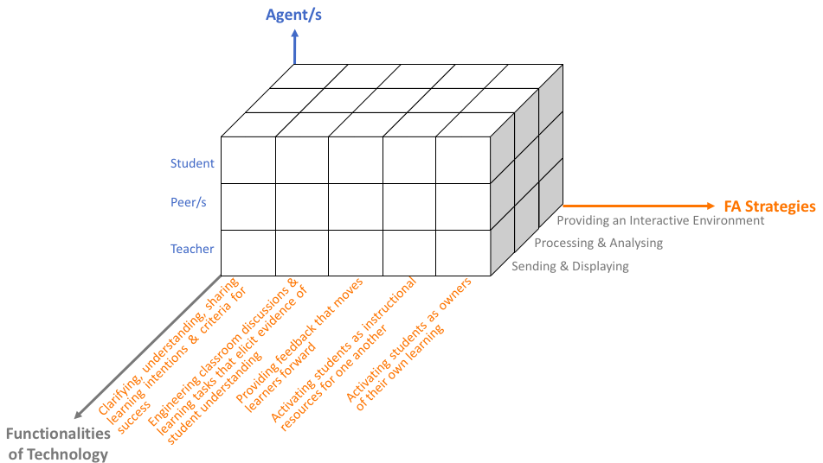
Activity A: Technology in the classroom (4)
Handout 2

Slide 8
Activity A: Technology in the classroom (5)
Is there something missing in the framework?
What is present and should not be?

Slide 9
Activity B: Sending and displaying (1)
Handout 3 lists some technologies which can be used to send and display work during a lesson.
Which technologies could help you understand the current levels of understanding of individual students?
Can you think of technologies which help students understand their own, or their peers’, current understanding?
What issues arise when student work is displayed for the whole class to see?

Slide 10
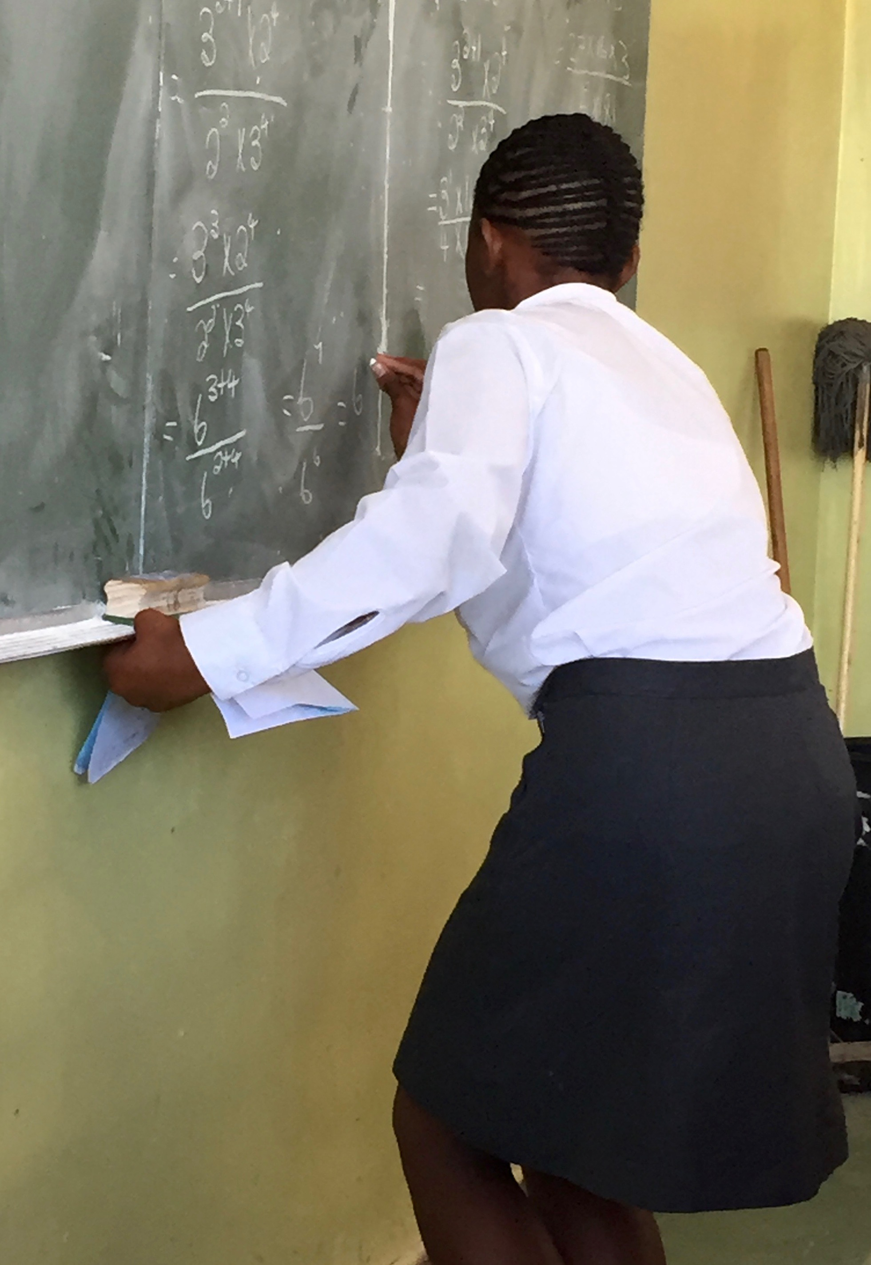
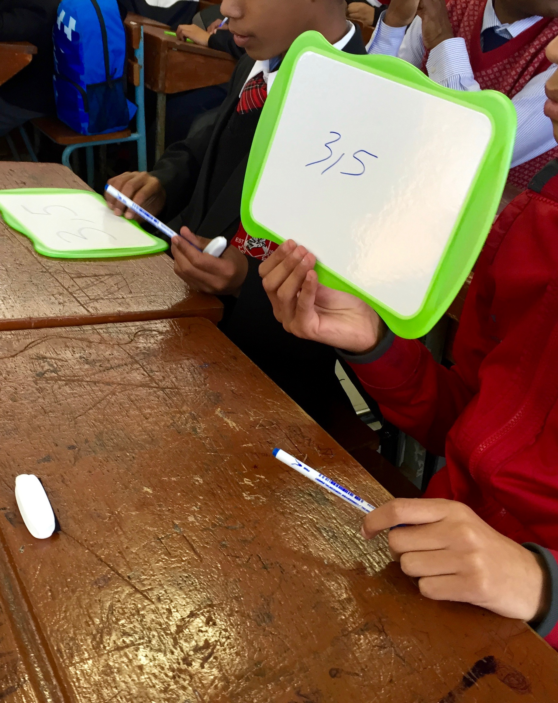
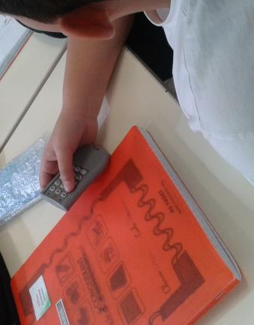
Activity B: Sending and displaying (2)

Slide 11
Activity B: Sending and displaying (3)
Handout 4 lists some technologies which can be used to send and display work before a lesson.
How could you use technology to send work to students before a lesson?
How would you use students’ work, completed prior to the lesson, for formative assessment?
What issues should teachers consider when sending work to be completed before a lesson?

Slide 12
Activity C: Processing and analysing (1)
Discuss the questions on Handout 5:
What are the benefits to you, as a teacher, of having information about how each student responded to each question?
What are the challenges associated with having so much information available?

Slide 13
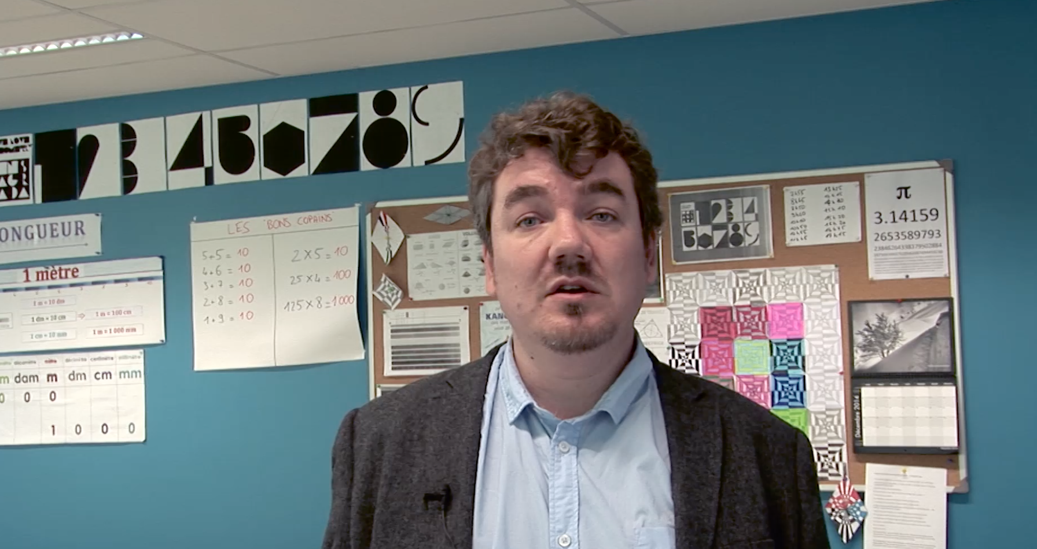
Activity C: Processing and analysing (2)
Video: Teacher using Clickers

Slide 14
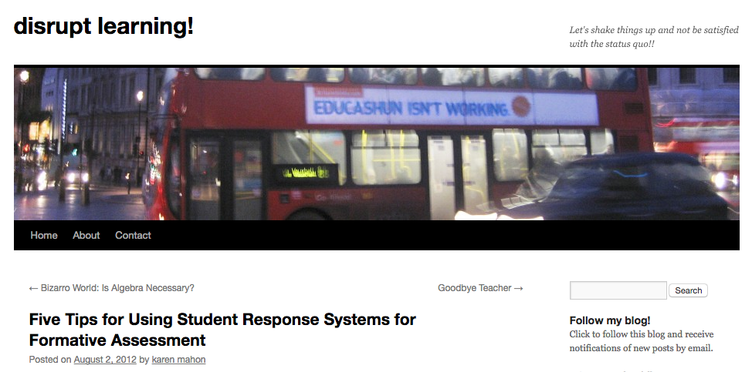
Activity C: Processing and analysing (3)
“Remember that the tool is only as good as the instruction with which you are using it. Figure out what you need to know and how you want to measure it.”

Slide 15
Activity D: Processing and analysing (1)
Computer-generated feedback is:
Immediate
Non-judgemental
No extra cost
Whether, when and how is computer feedback useful?
What is your experience of using computer feedback?

Slide 16
Activity D: Processing and analysing (2)
Video: Using computer generated feedback

Slide 17
Activity D: Processing and analysing (3)
Would you use this, or similar, software with your own classes?
Do you prefer either of the environments? Why?
How would your students respond to the feedback given by the computer?
To what extent is the feedback formative and helpful for student learning?
How would you improve the feedback?

Slide 18
Activity D: Processing and analysing (4)
Read through Handout 6: An expert’s view on using Mathspace and discuss as a group which of these views you share and which you disagree with.

Slide 19
Activity D: Processing and analysing (5)
Handout 6:
The main benefits of using the software for teachers
“…the program provided feedback directly to individual students in the form of ‘hints’ every time they entered their next stage of working. These ‘hints’ provided suggestions of what to think about rather than simply stating the correct ‘answer’.”
The main benefits of using the software for the students.
What advice would you give to teachers who want to use this, or similar, software?

Slide 20
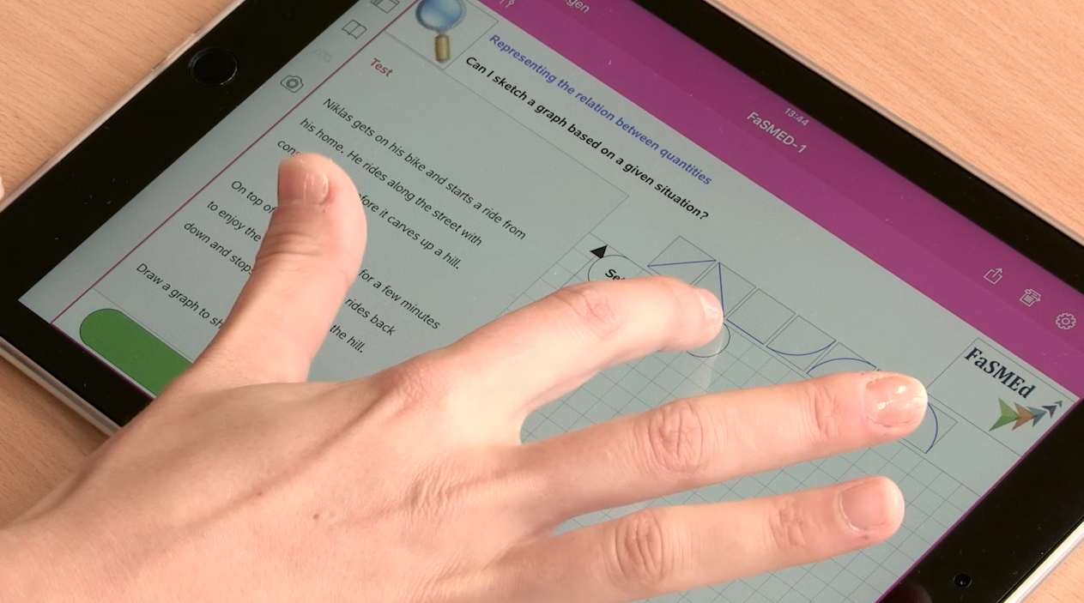
Activity E: Providing an interactive environment (1)
Video: Technology provides diagnostic feedback

Slide 21
Activity E: Providing an interactive environment (2)
Handout 7: Diagnostic feedback
What are the implications of using this software for your teaching?
How would your students respond to the software?
To what extent would you describe this software as formative?

Slide 22
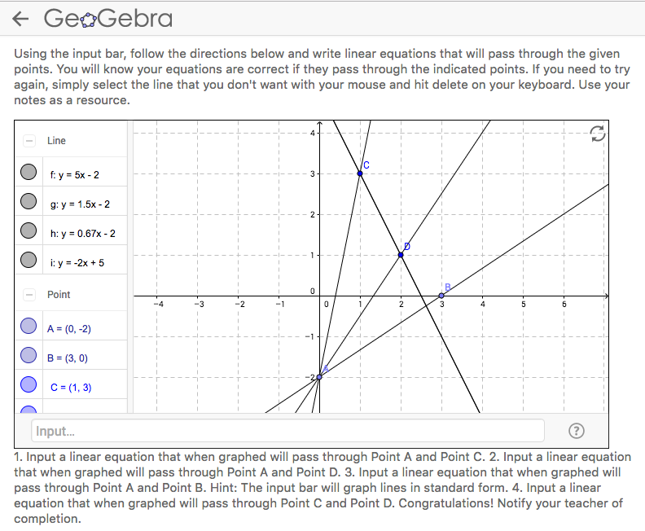
Activity F: Providing an interactive environment (1)
Video: Formative Assessment with GeoGebra

Slide 23
Activity F: Providing an interactive environment (2)
Questions from Handout 8: Examples from GeoGebra
What is the role of the GeoGebra in providing formative assessment?
What is the role of the teacher?
What sort of classroom norms would you need to establish in order to use GeoGebra in this way for effective formative assessment?

Slide 24
Activity F: Providing an interactive environment (2)
“My concern with the GeoGebra applet is that the person who made the applet has done the most interesting mathematical thinking. I love creating GeoGebra applets. I generally don’t have a good story for what students do with those applets, though. In this example, I suspect the student will drag the slider backwards and forwards, watching for when the numbers go from small to big and then small again, and then notice that the rectangle at that point is a square. The person who made the applet did much more interesting work.”
Dan Meyer
http://blog.mrmeyer.com/2016/who-wore-it-best-maximizing-area/

Slide 25
Overview
The FaSMEd framework
Sending and displaying
Processing and analysing
Providing an interactive environment.
What’s missing?
What should be taken out?

