Slide 1
Newcastle University Business School
Research Marketing Discussion
December 2025

Slide 2
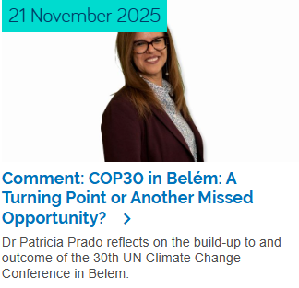
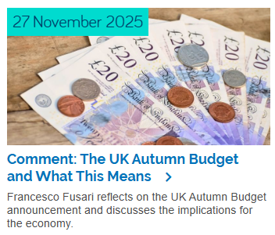
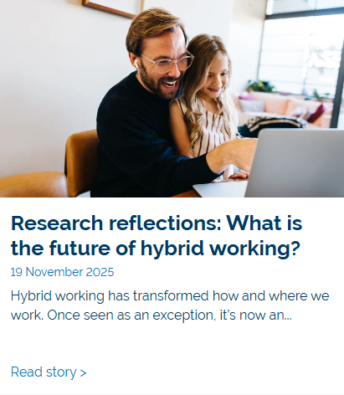
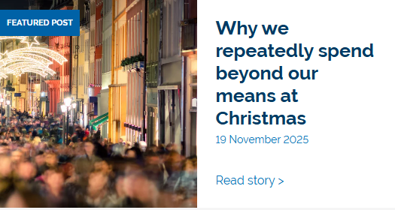

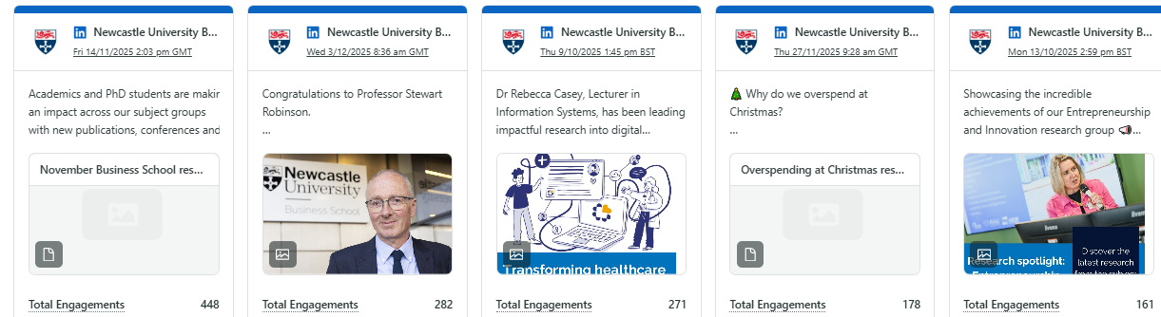
Content since the reporting period (August – now)
18 news stories on NUBS website (and promoted across our channels)
3 From blogs (1 currently in production) – all included in centrals paid campaign
40 social media posts
45,038 impressions
3,117 engagements
6.9% engagement rate
1,731 link clicks

Slide 3
Discussion:
Process of collecting research (collating info once instead of leading by channel)
Thoughts on research evangelists?
  Could SGHs send Research Manager, Gabrielle (research marketing lead) or Kylie thoughts on new initiative of evangelists / recommendations of who they could be?
Making messages more topical, relevant and quicker to get out (more informal / opinion based).
  Could the new research impact leads do a piece each?
Publications we want to appear in (professional bodies, specialist non-academic publications etc)?

Slide 4
NUBS website discussion
How the Research section is performing
The research section has attracted 6,185 users and 16,275 pageviews since launch in February.
Research group pages collectively receive the highest traffic within the section.
Research news and events continue to draw regular visits.
Some individual news stories and event listings have gained more page views than subject group pages.
How will we keep the research section up to date?
Specifically:
Spotlights – when and how do we refresh them?
Research news – how do we ensure a steady flow of research-led stories?
Events – how do we maintain accurate, timely and comprehensive listings?
Subject group updates – how often these should be reviewed, and by whom?

Slide 5
Upcoming themes: we need your help!
Themes
January and February: Creative Industries
March and April: Health and Wellbeing (tying in ethics and responsibility)
Topical content around awareness days (we are looking for academics to do comment pieces on the below)
International day of clean energy 26 January
World Wildlife Day 3 March
World Water Day 22 March
Global Day of Parents 1 June
G7 Summit 14 June
Small and medium sized enterprises day 27 June

Slide 6
Social tagging and handles
NUBS LinkedIn @Newcastle University Business School
NUBS X @NCLBusiness
HaSS LinkedIn TBC, currently being set up
HaSS X @HaSSFacultyNCL
HaSS BlueSky @hassfacultyncl.bsky.social
NCL LinkedIn @Newcastle University
NCL X @uniofNewcastle
NCL BlueSky @newcastleuni.bsky.social
#NCLBusiness #WeAreNCL
Tag the School and University accounts, use hashtags.
SGHs and R&ILs to encourage within their own groups.

Slide 7
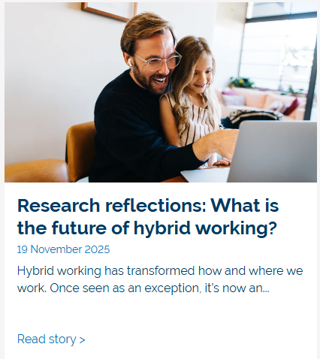
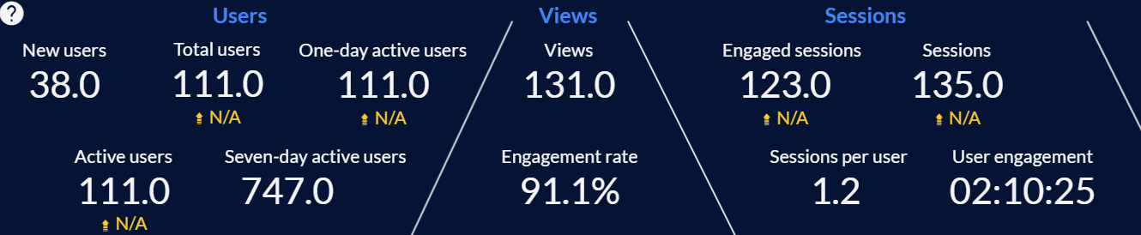
Case study – Professor Benjamin Badar
‘Work in progress’
Ben’s research was still ongoing, and he was recruiting participants for his study.
Central marketing spotted his LinkedIn posts and contacted NUBS marketing to introduce Ben and pitch the From blog opportunity.
With copy and research materials provided by Ben, central marketing produced a From blog that supported the recruitment of participants for Ben’s study but also to give an overview of the relevance and impact of the research so far.
This was promoted in central paid research campaign.
Web stats from 18 November – 4 December 2025

Slide 8
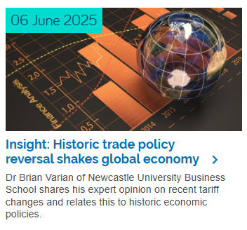
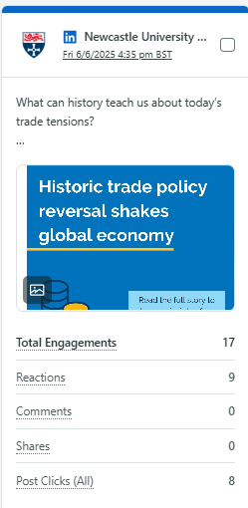
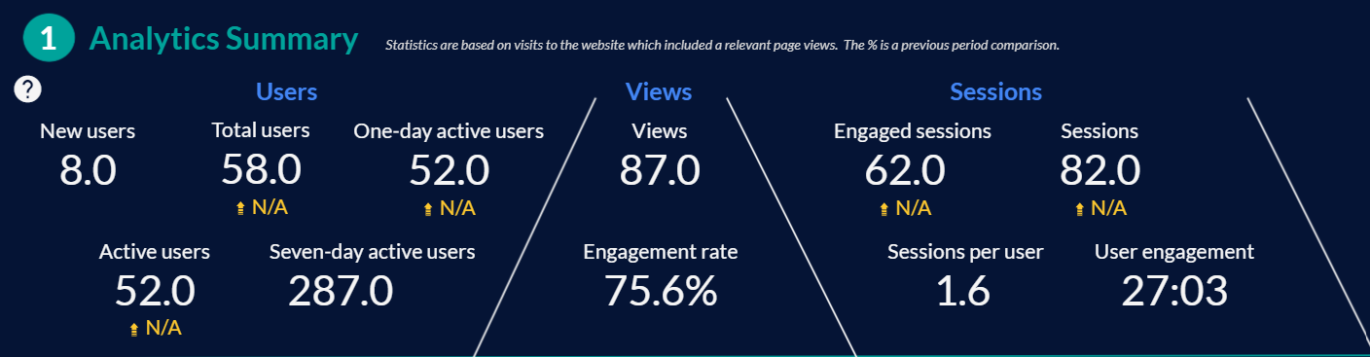
Case study – Dr Brian Varian
Repurposing content
Brian had already taken part in a radio interview on LBC Radio with host Matt Frei. This was very topical in April/May time when Trump imposed tariffs.
NUBS marketing spotted Brian’s post on LinkedIn and reached out to see if he would be happy to provide some context and research papers to repurpose the interview into a news article.
Brian approved the copy, and we set the article live on the NUBS website and promoted across our channels.
Web stats from 6 June – 4 December 2025

Slide 9
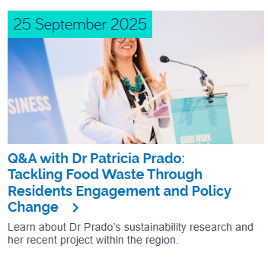
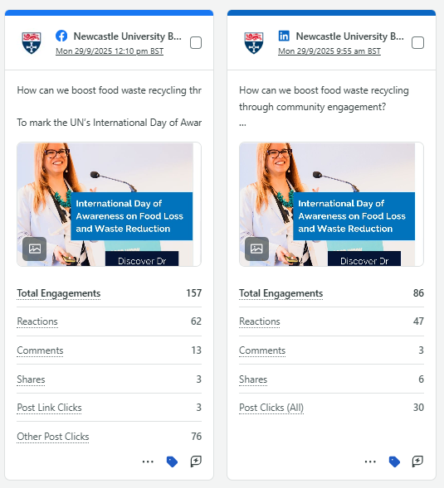
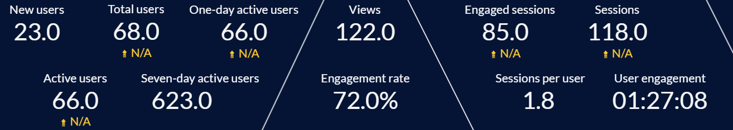
Case study – Dr Patricia Prado
NUBS marketing identified the UN SDG awareness day for food waste. Hannah Lynch recommended Patricia as someone who had done research in this area.
Patricia was approached and was happy to get involved. She tailored Q&A questions around her research project and provided answers to form a Q&A article.
Marketing proofed Patricia’s copy and set the article live on the NUBS website and promoted it across our channels.
Web stats from 25 September – 4 December 2025

Slide 10
Thank you
Any questions?

