Slide 1
Newcastle University Business School
Research Marketing Progress
December 2025

Slide 2
Improving our approach to marketing our research
To re-evaluate how we work and what we do to ensure we can continue to support the School’s reputation and work towards the School’s objectives.
Held a 3-hour discovery session in April with a range of stakeholders to gather ideas and make improvements.
Since the workshop we have explored processes and approaches for improving research visibility both internally and externally and completed initial agreed quick wins.

Slide 3
Initial actions implemented from workshop
Research report = showcasing what has been done so far and results
Going forward, these will be completed every 6 months
Topical content planning, including seasonal and thematic content

Slide 4

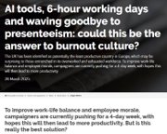
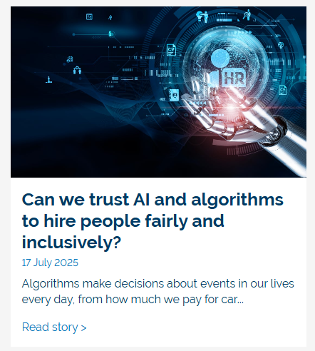
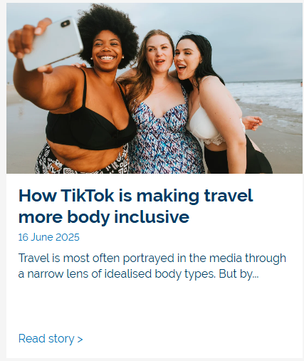
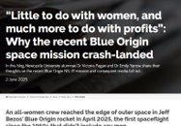
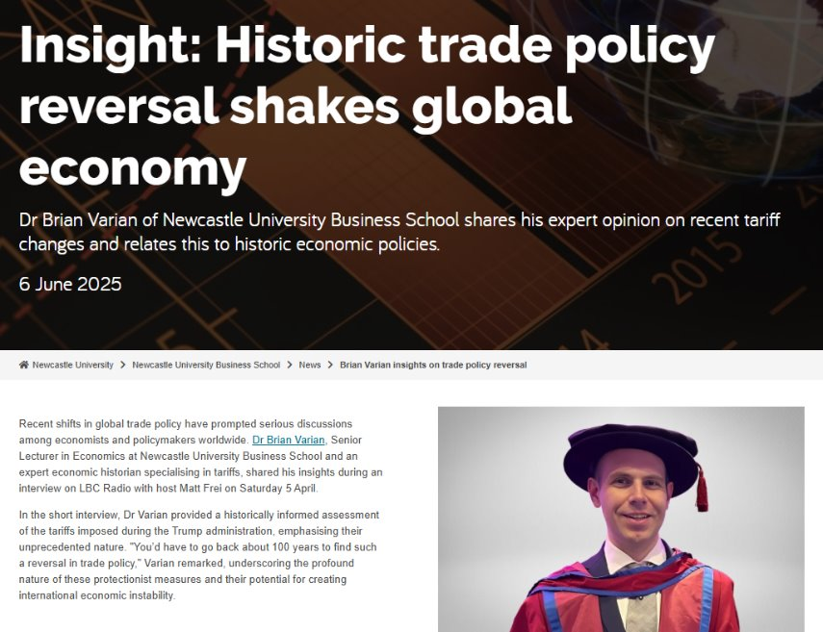
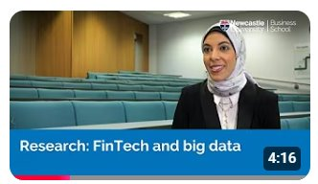
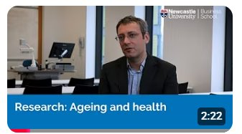
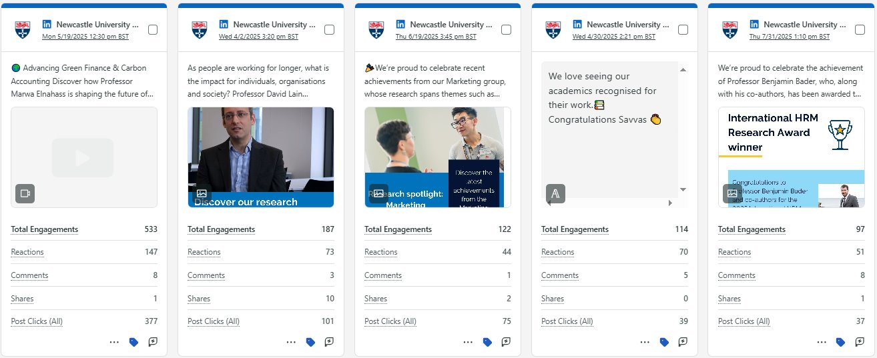
Examples of content (reporting period September 2024–July 2025)
2 From blogs (included in the Universities paid research campaign)
21 stories
5 videos
30 social posts

Slide 5
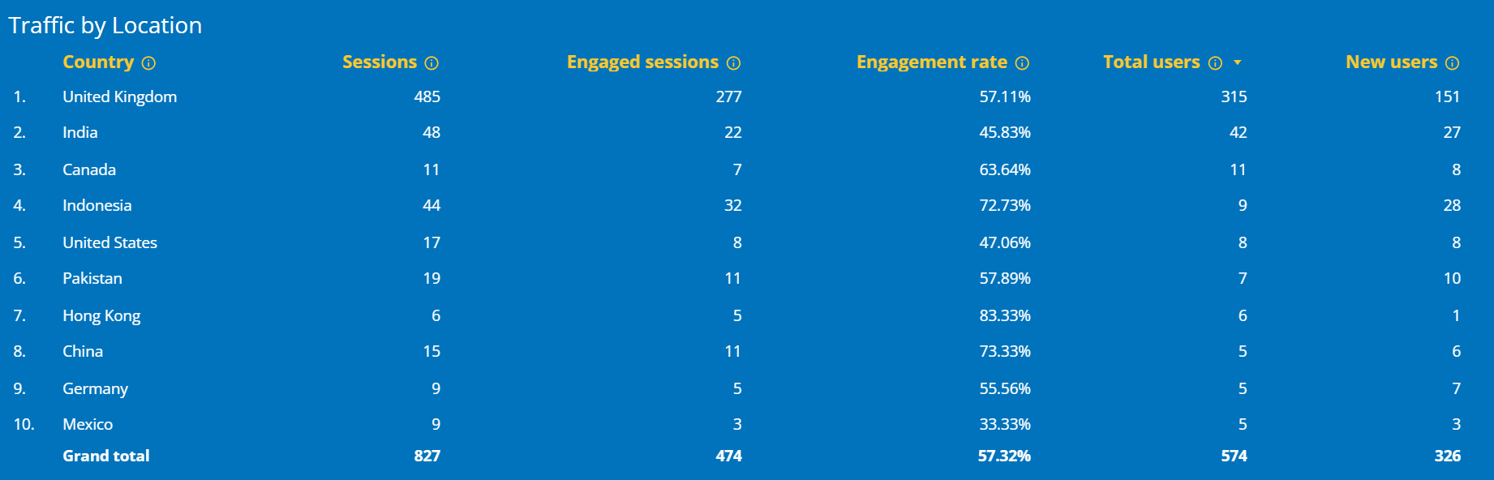
Key report findings
24,128 impressions
2,300 engagements
1,033 post link clicks
57.32% engagement rate
Average session 3 minutes, 11 seconds

Slide 6
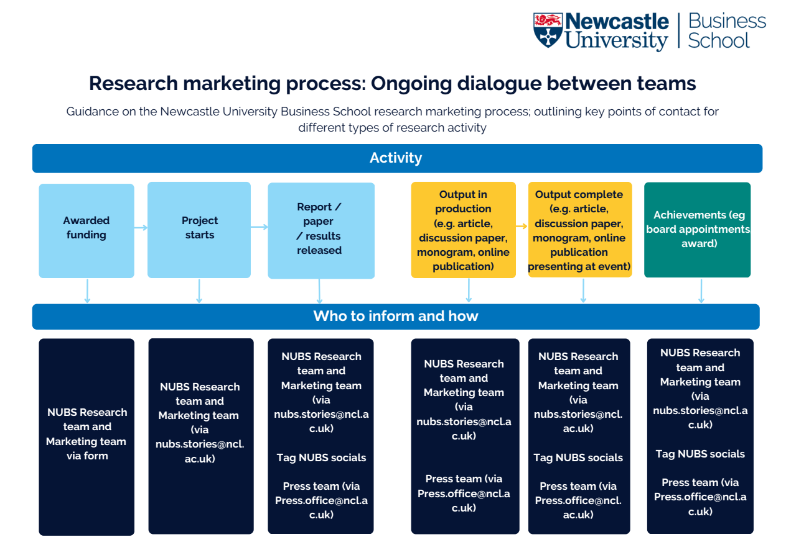
Resources and ways to contact us
Visual will be distributed / hosted on SharePoint
nubsmarketing@newcastle.ac.uk
NUBS.Stories@newcastle.ac.uk

Slide 7
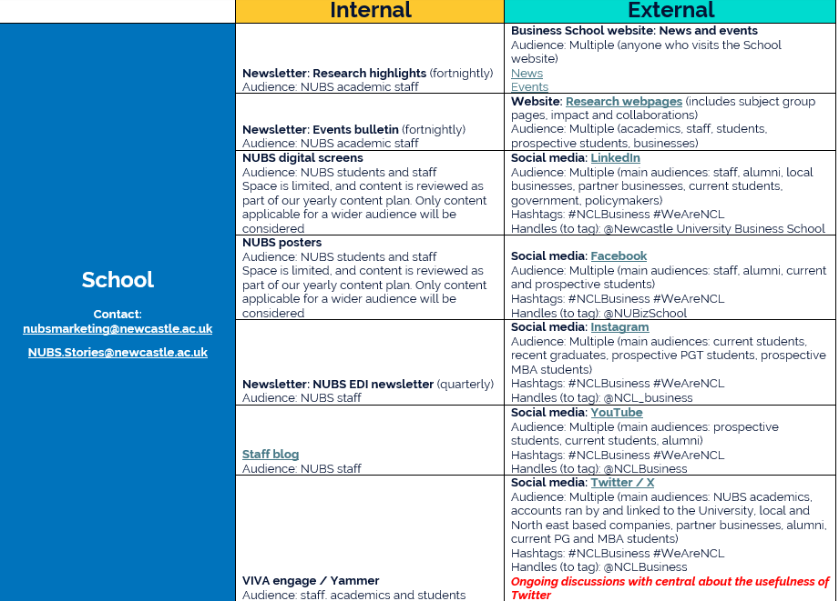
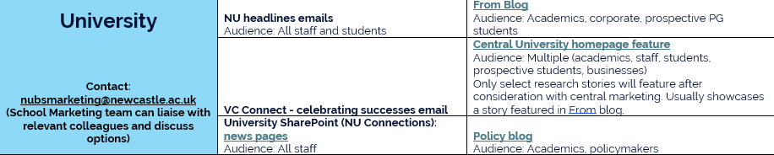
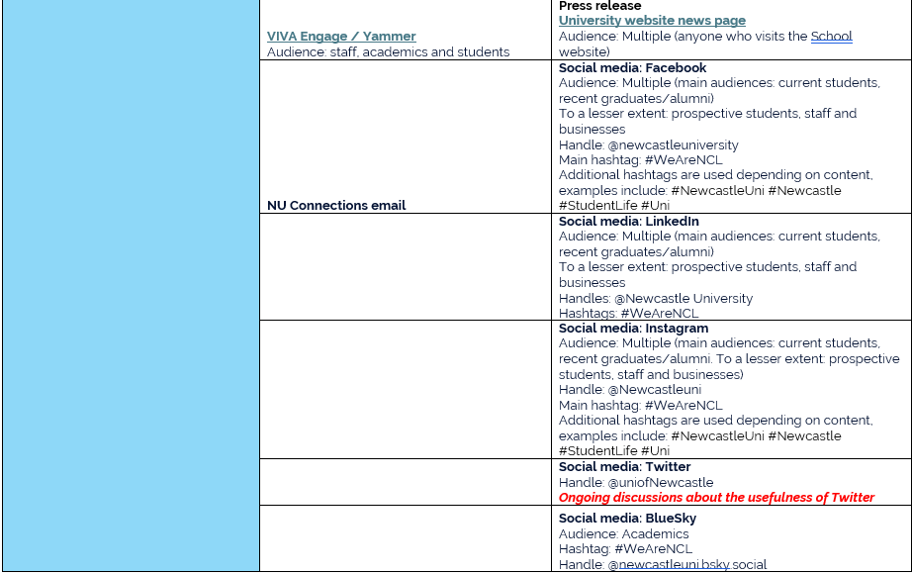
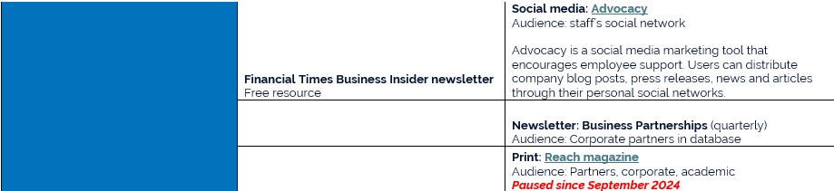
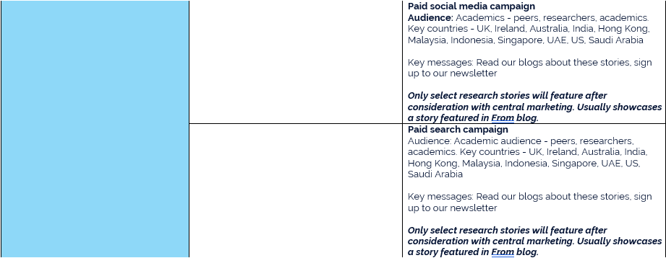
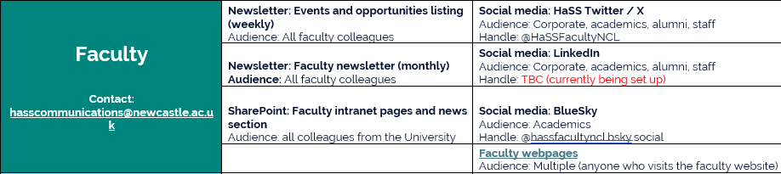
How we can promote our research

Slide 8
Social media
NUBS LinkedIn @Newcastle University Business School
NUBS X @NCLBusiness
HaSS LinkedIn TBC, currently being set up
HaSS X @HaSSFacultyNCL
HaSS BlueSky @hassfacultyncl.bsky.social
NCL LinkedIn @Newcastle University
NCL X @uniofNewcastle
NCL BlueSky @newcastleuni.bsky.social
#NCLBusiness #WeAreNCL
Tag the School and University accounts, use hashtags.
SGHs and R&ILs to encourage tagging and hashtags within their own groups.

Slide 9
Upcoming priorities
Subject Group Heads to add us to their group newsletter mailing lists.
NUBS marketing to regularly re-share academic posts.
We are working on mixing up the visuals and playing with messaging (polls, carousels of facts etc) for research socials.
Explore AI tools for podcasts (turning content of papers into something we can communicate).
Explore creating a mailing list with local policy makers and businesses – already do with BP newsletter. Will explore further in the new year.
Discuss with Business Partnerships team how we can link up thematic content with individual businesses we work with. Conversations have already started (research round table).
Priorities to discuss in R&IL meeting this afternoon…
Process of collecting research
Research evangelists
Making messages more topical, relevant and quicker to get out
Publications we want to appear in

Slide 10
School website
Context
Core website redeveloped in 2024–25 and launched Feb 2025. Research section is still evolving as content matures.
Primary goal of research section
To clearly communicate our research, why it matters, and guide users to explore it further.
Research section includes
Subject group research pages – communicate themes, people and major outputs
Impact (of School-wide research)
Collaborations (across School, University and institutions)
Research news feed (research stories only)
Listings of seminars, conferences and other research events
Development goal:
Strengthen engagement and make the research section easier to understand and navigate.
How:
ensure regular updates to research coverage, eg through spotlights, news and output summaries
surface key information earlier
improve structure and cross-linking
build out richer, more engaging content where needed

Slide 11
Thank you
Any questions?

